Slide 1
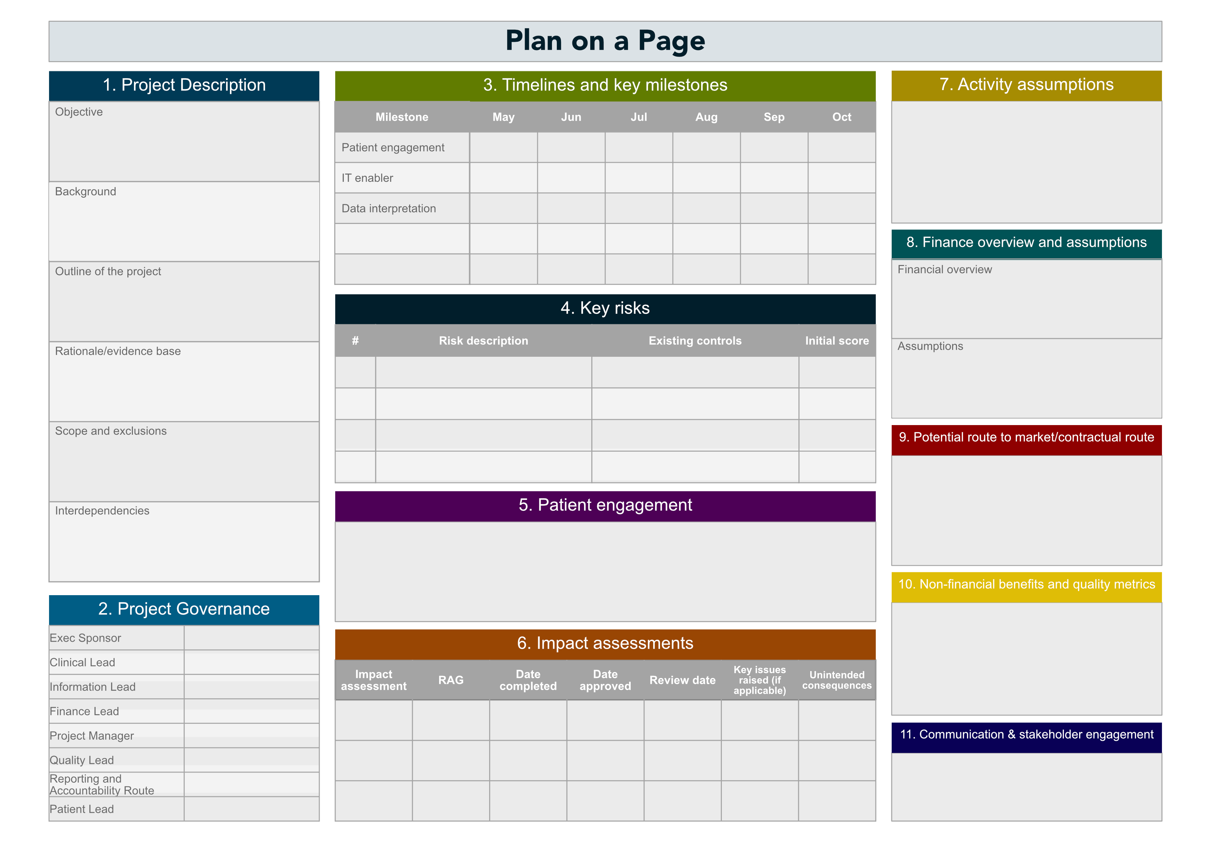
Plan on a Page
For more information on how to use this resource, see PCRS’s on-demand FeNO: Plan-on-a-page webinar at: https://www.pcrs-uk.org/resource/current/demand-webinar-feno-plan-page

Slide 2
A. Schneider et al. Diagnostic accuracy of FeNO in asthma and predictive value for inhaled corticosteroid responsiveness: A prospective, multicentre study. July 2022.
Improve the diagnosis of asthma within the PCN with the use of FeNO to reduce mortality and morbidity
From patients aged 5 and upwards
In line with the new NICE guidelines (July 2024) to use FeNO in patients aged 5 and over to improve the diagnosis of asthma.
Whole system integration – Vertical and horizontal integration
Incorporate the use of FeNO within the asthma service to improve both the sensitivity and specificity of the clinic.

Slide 3
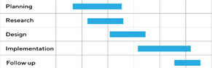
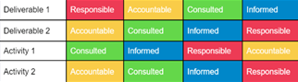
Corporate readiness
System readiness
https://www.apm.org.uk/resources/find-a-resource/gantt-chart/
https://project-management.com/understanding-responsibility-assignment-matrix-raci-matrix/

Slide 4
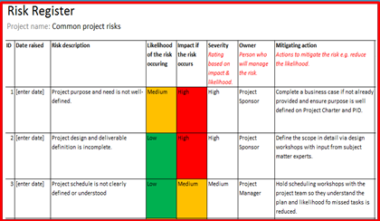
Strategic
External
Financial
Information Technology
https://www.stakeholdermap.com/risk/register-common-project-risks.html https://technologyadvice.com/blog/project-management/project-risks-examples/

Slide 5
https://www.nice.org.uk/guidance/ng245/chapter/Recommendations#initial-clinical-assessment

Slide 6
https://www.bbc.co.uk/news/articles/c4nn95zddgwo

Slide 7
Quality Impact Assessment
Equality Impact Assessment
Privacy Impact Assessment
BUT
https://democracy.kent.gov.uk/mgAi.aspx?ID=49041

Slide 8
Quality Impact Assessment
Equality Impact Assessment
Privacy Impact Assessment
YES
https://www.gov.uk/government/publications/northern-ireland-equality-scheme-for-hmrc/appendix-4-equality-analysis-guidance-and-template-for-programmes-platforms-projects-and-policies

Slide 9
Quality Impact Assessment
Equality Impact Assessment
Privacy Impact Assessment
YES
https://cy.ico.org.uk/for-organisations/advice-and-services/audits/data-protection-audit-framework/toolkits/accountability/risks-and-data-protection-impact-assessments-dpia/

Slide 12
PCN approach

Slide 13
Clinical outcomes
Patient experience PREM’S
Patient outcomes PROM’S
Clinician experience/productivity

Slide 14
