Slide 1
Action Learning Sets
FeNO Deployment Project
(Fractional exhaled nitric oxide)
V1 – 05/08/21

Slide 2
Purpose of this toolkit…
Use this toolkit to facilitate Action Learning Sets (ALSs) as part of your FeNO project deployment*
By looking at this ALS toolkit, we expect you have already made a decision (or decision in principle) to implement FeNO testing in your setting
The toolkit contains all the slides and materials you need to run 4 action learning sessions with your team. They can be run virtually or face to face. Each set should take around one hour, with the exception of session 2 which may need a little more time. Please use one or all sessions, and please amend as you see fit. You may wish to run session 3 multiple times during project deliver. There are ALSs covering;
Initial engagement
Project planning
Ongoing project deployment
Project close
If you need any more help with the use of this toolkit, or with your wider FeNO project, contact your local AHSN (Contact details available here)
*this ALS template has been developed as a guide by Wessex AHSN, sessions have not been independently assessed

Slide 3
Action Learning Set - ALSs
‘An action learning set (ALS) is a group of people within a workplace that meet with the specific intention of solving workplace problems. The main aim of an ALS is to come away with a set of realistic actions that will help to solve or understand the issues at hand.’*
* NHS Improving Quality

Slide 4
When, who and how should you use this ALS toolkit?
When
Throughout the life of a project as a regular opportunity to discuss issues faced by the project team – there is no limit on number. The meetings can cover a wide range of problems or focus on a particular issue or set of similar issues. The purpose of an ALS is to bring a team together to reflect and overcome barriers to progress.
Who
Any stakeholder can be involved – remember, this is a safe space where issues and problems will be discussed so participants must uphold honesty and confidentiality. Everyone taking part must be committed to the ALS in the spirit of contributing challenging but constructive questions. It is helpful to be clear on roles and responsibilities early in the sessions in order for discussions to represent all elements of the project that require consideration.
How
At the first meeting, ground rules for operating should be decided – these would usually include confidentiality, honesty and safety. After each presenter has explained their problem, members of the ALS encourage the presenter to learn by asking further questions. Each presenter should have an action plan once their slot has finished and should take responsibility for feeding back to the group on their progress.

Slide 5
When setting up your ALS, engage your team – their participation is vital for success
Your key stakeholders/project members will include colleagues from a range of disciplines. You will need to decide upon the following;
Project Lead
Clinical Lead (may be same as project lead e.g. Lead respiratory GP or Nurse
Finance/Procurement (e.g. Practice Manager)
Training (may be same as clinical lead)
Measurement/analytics
Admin

Slide 6
Prior to any ALS….
Ensure the team are up to speed and aware of any issues you are planning to discuss at the ALS
Seek input from the team to find out any additional issues for discussion
The national FeNO implementation toolkit (Using FeNO) has a wide range of background and support materials –browse the web pages to get an understanding of the project drivers, NICE Guidelines, FeNO products etc

Slide 7
Plan Do Study Act (PDSA)
You may want to use QI methodology as the structure for your ALSs
If so, you can find a handy guide here

Slide 8
PLAN/TEMPLATE FOR ACTION LEARNING SETS
ALS 1 – Initial project engagement

Slide 9
What is expected of you by taking part? – Agree your groups ‘ground rules’
Participants can challenge and support each other
A climate of confidentiality and openness is encouraged within the group
Participants are encouraged to seek solutions to real work issues and use real experience
Participants are encouraged to be explicit

Slide 10
Why are we here?
Explore:
Why do we want to implement FeNO testing in our setting?
Do we understand what FeNO measurement tells us?
Do we understand the benefits?
Are we happy with the evidence base?
Do we know why it will be valuable to us?
Are we open to doing this?
Are we ready to do this?
Do we understand some of the barriers to doing this?
How complex might our project be?
Do we have senior management support?
Do we definitely want to go ahead? Do we need any approvals to proceed?

Slide 11
Capture actions and assign tasks
Action | Assigned to | Date Due
Action 1 | [initials] | [Dd/mm/yy]
Action 2
Action 3
Action 4

Slide 12
PLAN/TEMPLATE FOR ACTION LEARNING SETS
ALS 2 – Project planning

Slide 13
Recap…What is expected of you by taking part? – Ground rules for the group
Participants can challenge and support each other
A climate of confidentiality and openness is encouraged within the group
Participants are encouraged to seek solutions to real work issues and use real experience
Participants are encouraged to be explicit

Slide 14
Team check in
How is everyone?
What’s going well?
Any problems/issues?
Challenges/blockers?
Are we all clear in our roles to plan this project?
Notes:
Root Cause Analysis (RCA) is a well recognised way of investigating how and why patient safety incidents happen.
Analysis is used to identify areas for change and to develop recommendations which deliver safer care for patients.
Identification of the ‘vital few’ causes that have a material impact on the outputs of a process
Analysis used to identify areas for change and to develop recommendations which deliver safer care for patients.

Slide 15
Project planning – the following slides will help you to
design, structure and plan your project…
Explore:
How are we going to implement FeNO?
What are we aiming to achieve? (completion of Driver Diagram will help with this, slide 16)
How might we evaluate success? (slide 17)
What are the key components in our plan? (see example plan on the FeNO Toolkit and slide 18)
What will the clinical pathway look like? (slide 19)
You can use the following questions to help you complete your planning;
How complex might it be?
How long might it take?
Who do we need to involve? (e.g. community respiratory teams, local hospital respiratory teams etc)
Who is going to take overall responsibility? Do we need any governance in place?
How are we going to make our project sustainable?
What documents do we need to support us? (see examples, e.g. template project plan or implementation checklist on the FeNO Toolkit)
How are we going to evaluate what we have done to see if we’ve been successful?
What else do we need to think about?

Slide 16
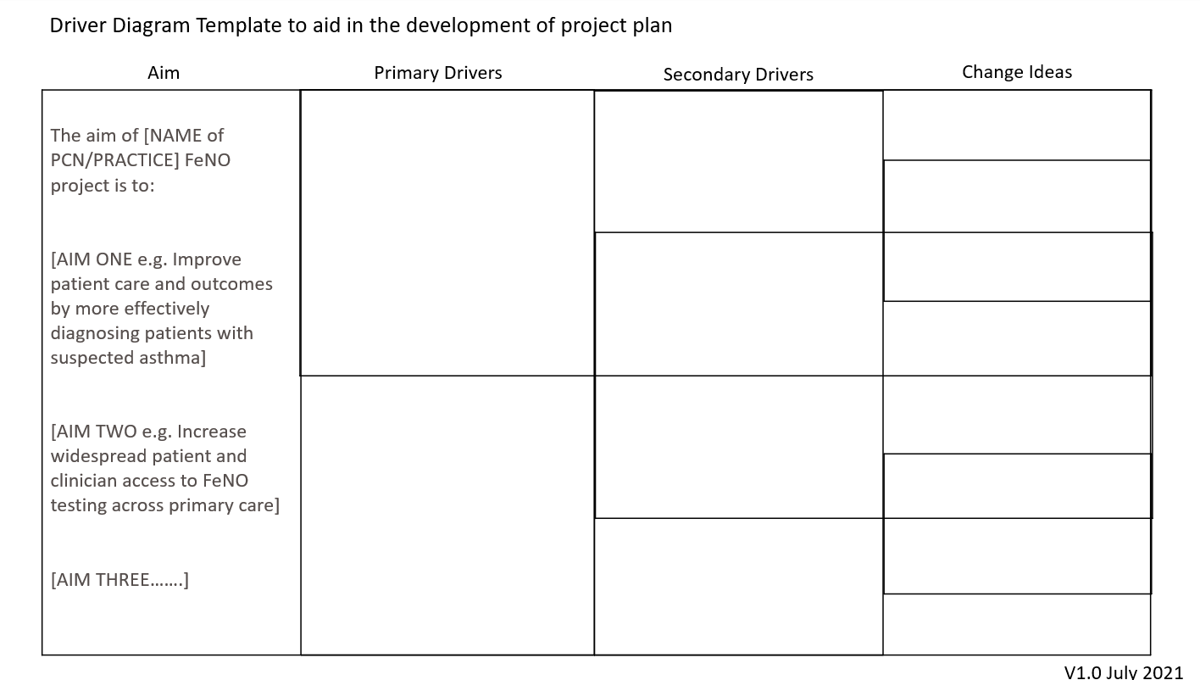
FeNO Project Driver Diagram
For discussion and completion
Link to this drive diagram template is here on the FeNO toolkit site
Don’t forget inclusion of how you intend to measure success
Notes:
To create a driver diagram:
• Start with a clearly defined, measurable goal or aim. It should describe what you intend to achieve and by when.
• Ask group to brainstorm potential drivers (i.e. the areas where improvement is needed).
• Cluster the ideas to create an agreed set of ‘drivers’’. Make sure you use language like “improve” or “decrease” and that each driver is clearly defined and measurable. • Discuss the need for new drivers or whether some of the drivers should be eliminated (if they are wrong or immaterial)
• Identify the links between the drivers to create primary, secondary and tertiary drivers.
• Get the group to identify any balancing goals or balancing measures
• Select improvement projects that you believe will impact upon your drivers.

Slide 17
Project evaluation planning
It's important to plan your project evaluation at the outset so you know what data to collect. You may want to review Quality Improvement measurement resources, such as the following, to help you decide what to measure;
https://www.england.nhs.uk/improvement-hub/wp-content/uploads/sites/44/2017/11/How-to-Guide-for-Measurement-for-Improvement.pdf
Explore:
What questions do we want to ask and answer?
How are we going to evaluate what we have done to see if we’ve been successful i.e. What are the measures of success (how do we define success) and how could we measure this? What data do we need to collect, when, where, how frequent etc. Do we / would we follow a QI measurement for improvement strategy?
Do we have someone who can do this / has the time to do this? How can we make this as simple as possible?
Who will read the evaluation (e.g. is it for us? Could we present at a conference? Is it to use as part of an ongoing Business Case for continued use?)
Do we need any advice?

Slide 18
Develop a plan for implementation
For discussion and completion
Utilise project planning template to ensure all necessary workstreams have been discussed and considered as part of plan.
Explore the template FeNO project plan here
Include milestones as date markers for your project development
Remember to capture and document any risks/issues and consider mitigation plan

Slide 19
Discussion around inclusion of FeNO in
Clinical Pathway – led by Clinical Lead
Where should FeNO sit in our respiratory pathway?
How do we incorporate it?
Links to NICE pathways
For 18 years+
https://www.nice.org.uk/guidance/ng80/resources/algorithm-c-objective-tests-for-asthma-in-adults-aged-17-and-over-pdf-4656176751
For 5 to 17 years https://www.nice.org.uk/guidance/ng80/resources/algorithm-b-objective-tests-for-asthma-in-children-and-young-people-aged-5-to-16-pdf-4656176750
Notes:
Root Cause Analysis (RCA) is a well recognised way of investigating how and why patient safety incidents happen.
Analysis is used to identify areas for change and to develop recommendations which deliver safer care for patients.
Identification of the ‘vital few’ causes that have a material impact on the outputs of a process
Analysis used to identify areas for change and to develop recommendations which deliver safer care for patients.

Slide 20
Capture actions and assign tasks
Action | Assigned to | Date Due
Action 1 | [initials] | [Dd/mm/yy]
Action 2
Action 3
Action 4

Slide 21
PLAN/TEMPLATE FOR ACTION LEARNING SETS
ALS 3 - Ongoing project deployment
(This session can be repeated as many times as needed)

Slide 22
Recap…What is expected of you by taking part? – Ground rules for the group
Participants can challenge and support each other
A climate of confidentiality and openness is encouraged within the group
Participants are encouraged to seek solutions to real work issues and use real experience
Participants are encouraged to be explicit

Slide 23
Team check in
How is everyone?
What’s going well?
Any problems/issues?
Challenges/blockers?
What are our reflections on progress so far?
Do we need to change anything/any areas of improvement? (to be better/to address a problem etc.)?
Are we all clear in our roles to make this project a success?

Slide 24
Review implementation plan- are we on track to
meet milestones?
Update project plan with latest information
Check milestones, have they been met?
Check for any delays/barriers and discuss plan to mitigate
Review and update risks/issues and mitigation plan

Slide 25
Re-visit discussion around inclusion of FeNO in
Clinical Pathway….
Have we got our use of FeNO in the right part of our pathway?
Is our pathway still working for
1) our patients? 2) our clinical team(s)?
Links to NICE pathways
For 18 years+
https://www.nice.org.uk/guidance/ng80/resources/algorithm-c-objective-tests-for-asthma-in-adults-aged-17-and-over-pdf-4656176751
For 5 to 17 years https://www.nice.org.uk/guidance/ng80/resources/algorithm-b-objective-tests-for-asthma-in-children-and-young-people-aged-5-to-16-pdf-4656176750

Slide 26
Capture actions and assign tasks
Action | Assigned to | Date Due
Action 1 | [initials] | [Dd/mm/yy]
Action 2
Action 3
Action 4

Slide 27
PLAN/TEMPLATE FOR ACTION LEARNING SETS
ALS 4 – Project close and evaluation

Slide 28
Recap…What is expected of you by taking part? – Ground rules for the group
Participants can challenge and support each other
A climate of confidentiality and openness is encouraged within the group
Participants are encouraged to seek solutions to real work issues and use real experience
Participants are encouraged to be explicit

Slide 29
Team check in
How is everyone?
What’s going well?
Any problems/issues?
Challenges/blockers?
What are our reflections on progress so far?
Do we need to change anything/any areas of improvement? (to be better/to address a problem etc.)?
Are we all clear in our roles to make this project a success?

Slide 30
Project Progress
Review latest updates
Have milestones been met?
Check for any delays/barriers and discuss plan to mitigate
Review and update risks/issues and mitigation plan
Review sustainability, can we move to business as usual?
Review early data, if available

Slide 31
Project close and evaluation
Has this gone well?
How could we improve?
Now we are closing our project, is everything in place for this new pathway and test to become our new/usual pathway?
The project could have been even better if we….
What have we learnt? What is the learning we’d share?
Can we answer the questions we set in our evaluation plan?
What does the data say?
So what does our evaluation mean?
Can we share/promote out work? With who?
Who is going to write up our project evaluation? (suggested evaluation template here)

Slide 32
RESOURCES
https://wessexahsn.org.uk/programmes/56/feno-fractional-exhaled-nitric-oxide
FeNO Testing - AHSN RUP & MTFM Implementation Network - FutureNHS Collaboration Platform
https://www.england.nhs.uk/improvement-hub/wp-content/uploads/sites/44/2017/11/How-to-Guide-for-Measurement-for-Improvement.pdf
https://www.england.nhs.uk/sustainableimprovement/qsir-programme/

