Slide 1
Asthma Guideline 2024
<Add your own title here>
Case studies
This work is licenced under CC BY-NC 4.0

Slide 2
Case study 1
Child asthma death

Slide 3
Child asthma death
COMING SOON
Notes:
Take out and have separately

Slide 4
Case study 2
Young person asthma death

Slide 5
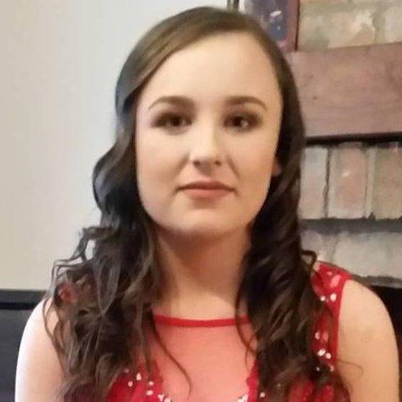
“We lost our daughter to asthma and want people to take it more seriously”
Nearly five years on the family are still campaigning for better care and awareness of the chronic lung condition that affects 36,000 children in Northern Ireland (NI)
A+L UK Released on 3rd May 2023
A father from County Down whose daughter died from an asthma attack has said people have become too complacent about the condition.
Rachel Williamson was 16 years old when she died after suffering an attack at home in Portavogie in 2017. Her father, Simon, has launched an asthma awareness initiative for teenagers, believed to be the first of its kind in the UK and Ireland.
About one in 10 people in NI have asthma, including 36,000 children.
Many asthma deaths can be prevented through correct use of inhalers and regular check-ups.
But in 2017, the last year for which figures are available, 38 people in NI died from it.
Asthma death: Bereaved father warns about complacency
BBC News NI Published 28 September 2019: www.bbc.co.uk/news/uk-northern-ireland-49838240

Slide 6
Case study 3
Adult asthma death

Slide 7
Case study: 35-year-old female
Demographics:
Single, 4 children (one with significant needs)
Support system:
Support from mother, friends, and ex-partners
Past medical history:
Asthma (diagnosed aged 3)
Highest eosinophils 0.25
No lung function available
Mental health:
Anxiety
Depression
Lifestyle:
Smokes 20 cigarettes/day
Medication
Trimbow 172/5/9 II puffs BD (12 issues in 12/12)
Montelukast 10mg ON (12 issues in 12/12)
Salamol 100mcg II puffs BD (31 issues in 12/12) – 20+ Rx issues
Venlafaxine 225mg OD (12 issues in 12/12)
X10 Prednisolone courses in 12/12
X1 issue of salbutamol 2.5mg nebules (40 nebules) but also had access to relatives nebules
X20+ short-acting beta-agonist (SABA) 12/12

Slide 8
Medical history & service engagement
2019: Referred to respiratory medicine, refused admission, did not attend
June 2022: Intensive care unit (ICU) admission post C-section, followed by asthma flare (high flow o2), self-discharged, warned of death risk
July 2022: Referred to respiratory medicine, did not attend
Sept 2023: Asthma risk identified, invited for specialist review, did not attend
Ongoing: Poorly controlled asthma, missed multiple reviews, only attended during exacerbations
Mental health: Anxiety impacted engagement with services, known to mental health services, poor attendance

Slide 9
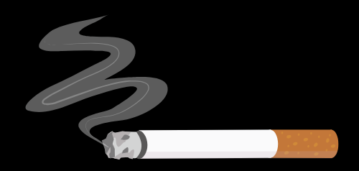
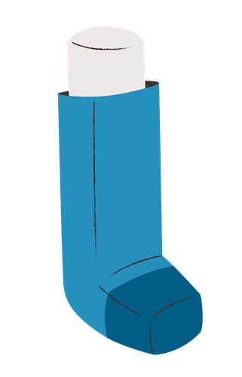
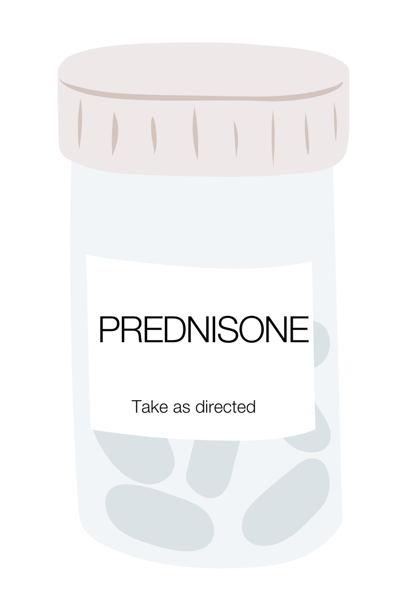
Red flags
Not attending appointments / reviews
Mental health
Tobacco dependency and the wider environment
Multiple courses of oral steroids
SABA overuse
Notes:
SABA – Short-acting beta-agonists

Slide 10
Last encounter
Critical event
Early December 2024
2 weeks prior:
Prescribed prednisolone for asthma flare, symptoms improved initially, but returned after 5-7 days
Presenting symptoms:
Productive cough, shortness of breath on exertion (SOBOE), chest tightness, wheeze
Clinical findings:
Widespread inspiratory & expiratory wheeze on auscultation
SpO2 88% on room air, RR 20, HR 91 bpm
Decision:
Admission declined; patient had capacity to refuse
Advised of risk of death
Christmas 2024
Initial symptoms:
Patient experienced shortness of breath (SOB) in the afternoon
Breathing deteriorated into the evening
Immediate action:
Patient independently administered 5mg salbutamol via nebuliser
Critical event:
Patient stopped responding and ceased breathing during nebuliser treatment
Emergency response:
Family dialed 999 (emergency services)
Emergency services instructed family to initiate CPR
Outcome:
Sadly, patient passed away (RIP)

Slide 11
Key lessons
High SABA and steroid use: Over-reliance on SABA and oral steroids indicates poor asthma control, red flags for risk.
Poor engagement with health services: Consistent non-attendance and missed appointments demonstrate the danger of neglecting regular medical care, even with escalating symptoms.
Mental health impact: Anxiety and fear of hospitalisation contributed to non-compliance, highlighting the need for better mental health support in managing physical health.
Health literacy: Lack of understanding about asthma management and risks led to ineffective self-care.
Risk awareness: Despite being advised of high mortality risk, the patient’s decision-making emphasises the need for clear communication and support around life-threatening consequences amongst multiple health and social services.
Notes:
SABA – Short-acting beta-agonists

Slide 12
Case study 4
Add your own local asthma death

Slide 13
Slide for local story
Do a search for the last asthma death (child or other) in your local area – include a summary of this, news clippings and key learning points.

