Slide 1

Asthma Guideline 2024
An Education Pack for Integrated Care Boards (England), Health boards and Trusts (Northern Ireland, Scotland and Wales)
An introduction to the 2024 BTS/NICE/SIGN asthma guideline and how to implement it
This work is licenced under CC BY-NC 4.0

Slide 2

Contents
How to use this education pack
BTS/NICE/SIGN asthma guideline
Introduction to asthma
Asthma prevalence and facts
Getting the diagnosis right
The right treatment pathway
Self-management
Monitoring progress
Resources and references
  PCRS resources
  Asthma and Lung UK respiratory champions and resources
  Other resources
  References
Click to jump ahead to the section you need

Slide 3
How to use this Education pack
This education pack has been produced by the Primary Care Respiratory Society (PCRS) as part of its ICB/Health board/Trust toolkit which aims to support UK healthcare commissioners to implement the new asthma guideline.
The education pack provides key information about asthma and the new asthma guideline.
Use it to enhance your knowledge of asthma and the new guidance, as well as what your ICB/Health board/Trust needs to do to implement it effectively.
The PCRS ICB/Health board/Trust toolkit includes:
  Summary infographic: Key information for commissioners on implementing the new asthma guideline.
  Full education pack: All the information you need to know about asthma and the new asthma guideline.
  Some slides have been hidden – unhide these for supplementary information.
  Presentation slide set: Use this to present the case to your commissioning board/manager.
  Asthma death case studies: Three case studies which show why it is so important we get it right.
  Summary resource: ‘First steps to implementing the new asthma guideline’. Share this resource with your primary care services.
  FeNO plan on a page: A resource and on-demand webinar on how to pitch FeNO to healthcare commissioners.
  Patient video: Hear from some of the PCRS patient reference group on why implementing the new asthma guideline is so important to individuals with asthma.
Check the notes sections of both presentations for additional information and speaker notes

Slide 4
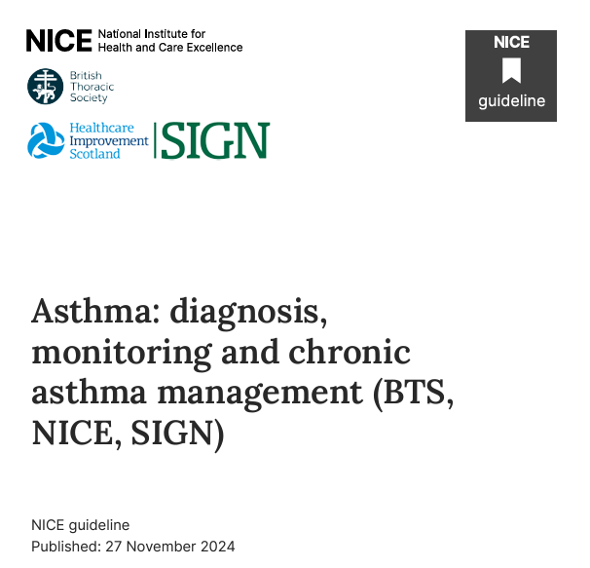
BTS/NICE/SIGN Asthma guideline
A unique opportunity to change and transform asthma care in the UK
New collaborative guidelines transforming asthma management in the UK
Focuses on evidence-based approaches for diagnosis and treatment
Consistency across healthcare commissioners in England, Northern Ireland, Scotland and Wales for effective implementation
https://www.nice.org.uk/guidance/ng245
Notes:
Reference = 2. BTS/NICE/SIGN asthma guideline 2024

Slide 5
Background and purpose
Why do these guidelines matter?
The BTS (British Thoracic Society), SIGN (Scottish Intercollegiate Guidelines Network), and NICE (National Institute for Health and Care Excellence) have collaborated to create updated guidelines for asthma care.
These guidelines provide a unified, evidence-based approach to diagnosis, treatment, and management of asthma across all age groups.
They aim to improve asthma outcomes, reduce healthcare inequalities, and ensure best practice in primary and secondary care.
Standardised care: Ensures consistent asthma management across all healthcare settings, improving patient safety and outcomes.
Health equity: Addresses disparities in asthma care, supporting targeted interventions for high-risk populations.
Cost-effective management: Encourages appropriate diagnosis and use of medications (e.g. reducing over-reliance on short-acting beta-agonists (SABAs)) and prevention-focused strategies to lower hospital admissions.
Environmental & sustainability considerations: Encourages the use of low-carbon inhalers and environmentally conscious asthma care practices.
Notes:
Notes:
See slides 25 -28 for more information on SABAs.

Slide 6

Introduction to asthma

Slide 7
Asthma – why our health community?
Asthma is a common condition affecting people throughout their lives.
If not managed well:
It has a high cost to the health service (hospital admissions, unscheduled GP visits and medication costs).
It has a high cost to society (time from school/work and disability).
It can result in high-profile deaths in children and young people, which highlight weaknesses in care.
The new guideline is a chance to change the face of asthma care
It has the potential to harness expertise across boundaries and many interested clinicians are keen to provide better care.

Slide 8
Asthma prevalence
The number of people affected by asthma in the UK is amongst the highest worldwide.
Up to 5.4 million people in the UK are receiving treatment for asthma. Asthma accounts for high numbers of consultations in primary care, out-of-hours services, and hospital emergency departments.
Asthma is the most common long-term medical condition in children in the UK with around 1:11 children and young people living with asthma.
The UK has one of the highest prevalence, emergency admission and death rates for childhood asthma in Europe. Outcomes are worse for children and young people living in the most deprived areas.
Notes:
References = 1. Asthma and Lung UK (Asthma Statistics), 8. NHS England (Asthma) and 9. RCPCH. State of Child Health. 2020

Slide 9
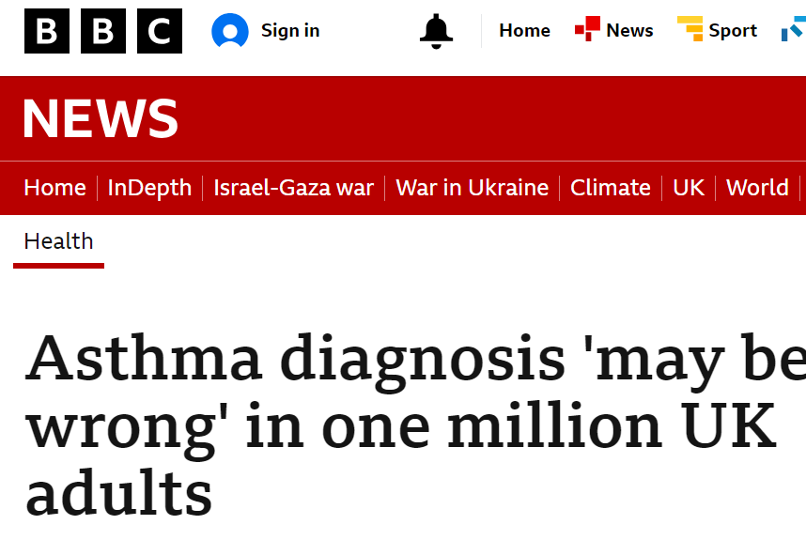
Asthma facts
NICE report that a third of adults diagnosed with asthma have no actual clinical signs of asthma.
Asthma can be under-diagnosed as well - with eight out of ten asthma sufferers still not getting the correct basic care.
Overdiagnosis of asthma is thought to be common in children leading to unnecessary treatment, disease burden, and impact on their quality of life.
Ten years on from the National review into Asthma Deaths (NRAD) published in 2014 – the annual asthma death toll has risen by 25%.
Notes:
Reference = 7. National Institute for Health and Care Excellence (NICE)

Slide 10



Respiratory Care Action Plan
Key priorities
Getting the diagnosis right
Getting the asthma treatment right
Getting the asthma training right
Notes:
Speaker notes:
Getting the diagnosis right
Investing in testing tools such as FeNO and spirometry
Getting the asthma treatment right
Supporting local incentives to review the treatment of people with asthma in accordance with the new guideline
Raising awareness of the risks associated with short-acting beta-agonist (SABA) free pathways
Getting the asthma training right
- Adopting Fit to Care across entire workforce to ensure all have appropriate knowledge, skills and training of healthcare professionals treating individuals with asthma
- Provide educational updates to the workforce on the new guidelines via PCRS slide kits and online learning modules

Slide 11
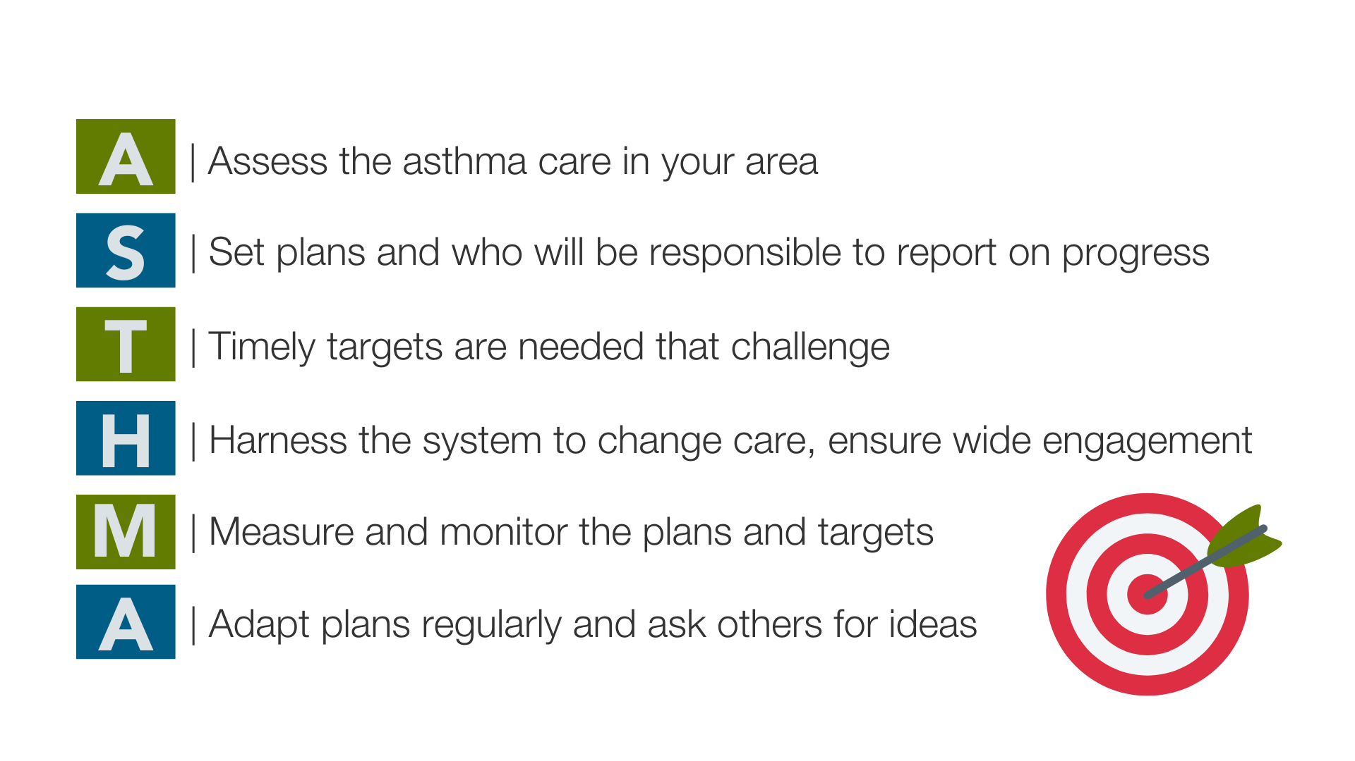
The ASTHMA Challenge:

Slide 12

Think children and young people
It is very important to consider what specific requirements children and young people (CYP) will need to ensure effective implementation of the new asthma guideline across all age groups and cultures. The right support, in the right place will ensure all children and young people with asthma to live happy, healthy and inclusive lives.
This should include:
  Diagnosis and treatment pathways and ensuring they are appropriate for CYP in your area
  Effective transition services (between paediatric and adult care settings)
  Who they need access to, as well as what paediatric specific education and training these people will need, and
  How information and guidance will be communicated to them (method, format and language) to ensure they, and their parent/carer, can self-manage their condition and feel in control of it.
  Throughout this toolkit, we have provided some CYP specific guidance but always remember to ‘Think children and young people!’

Slide 13
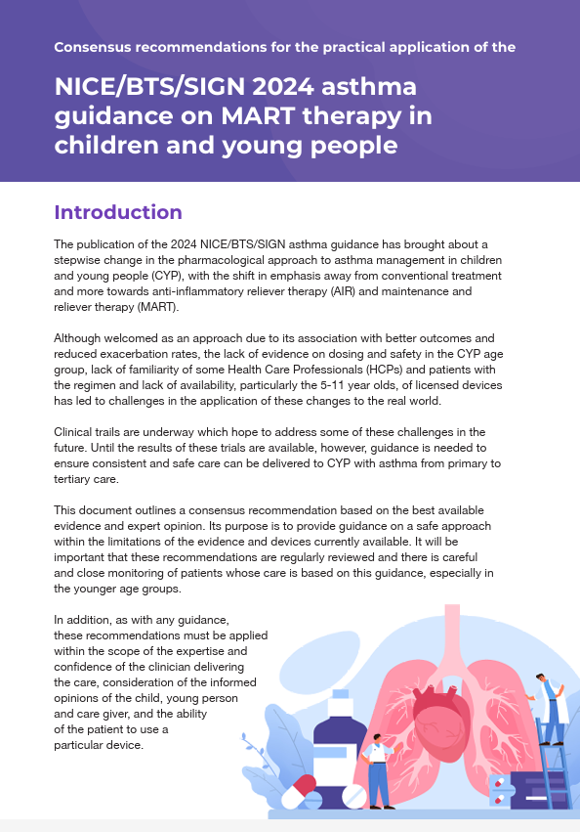
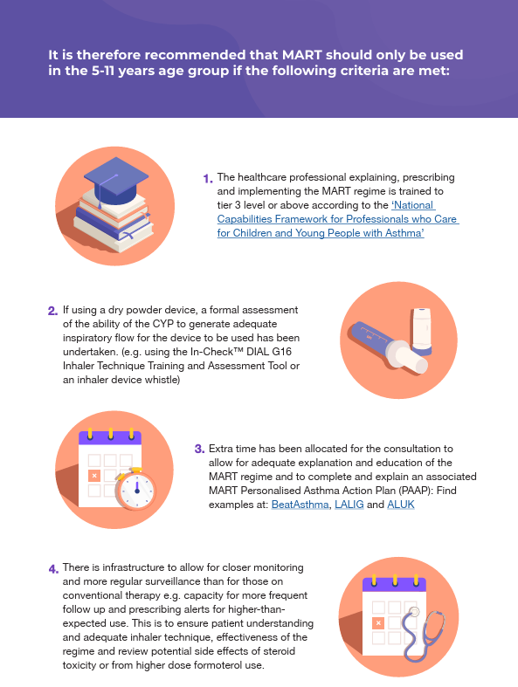
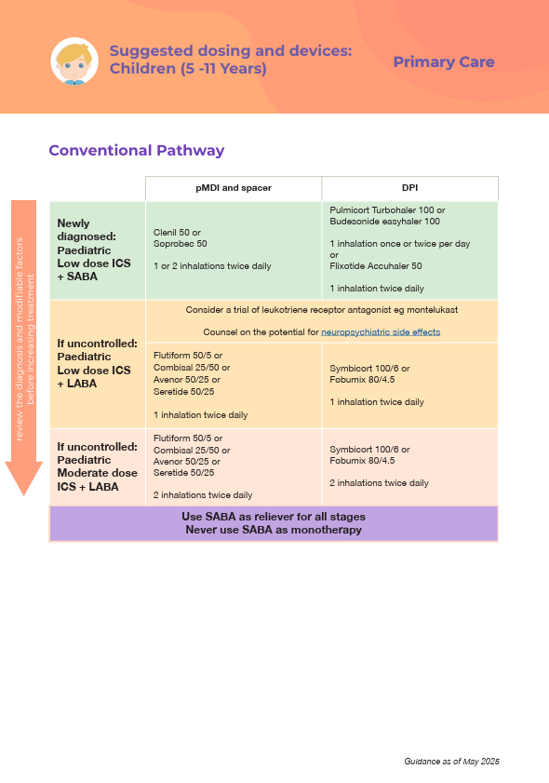
NHS England CYP MART infographic
NHS England has produced an infographic specifically on the implementation of maintenance and reliever therapy (MART) for children and young people.
Please access this here: https://www.beatasthma.co.uk/wp-content/uploads/2025/04/MART-Consensus-statement-FINAL.pdf

Slide 14

Getting the diagnosis right

Slide 15



“As many as 750,000 people in England are misdiagnosed with asthma, costing an estimated £132 million every year”.
Notes:
Reference = 1. Asthma and Lung UK

Slide 16


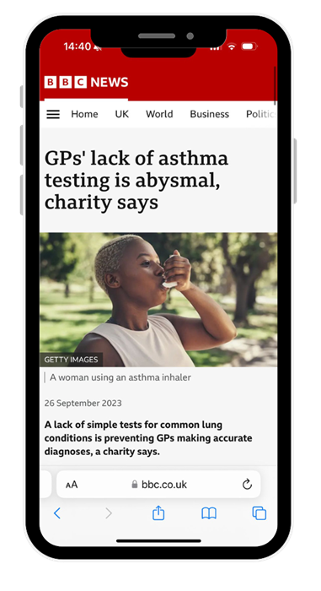
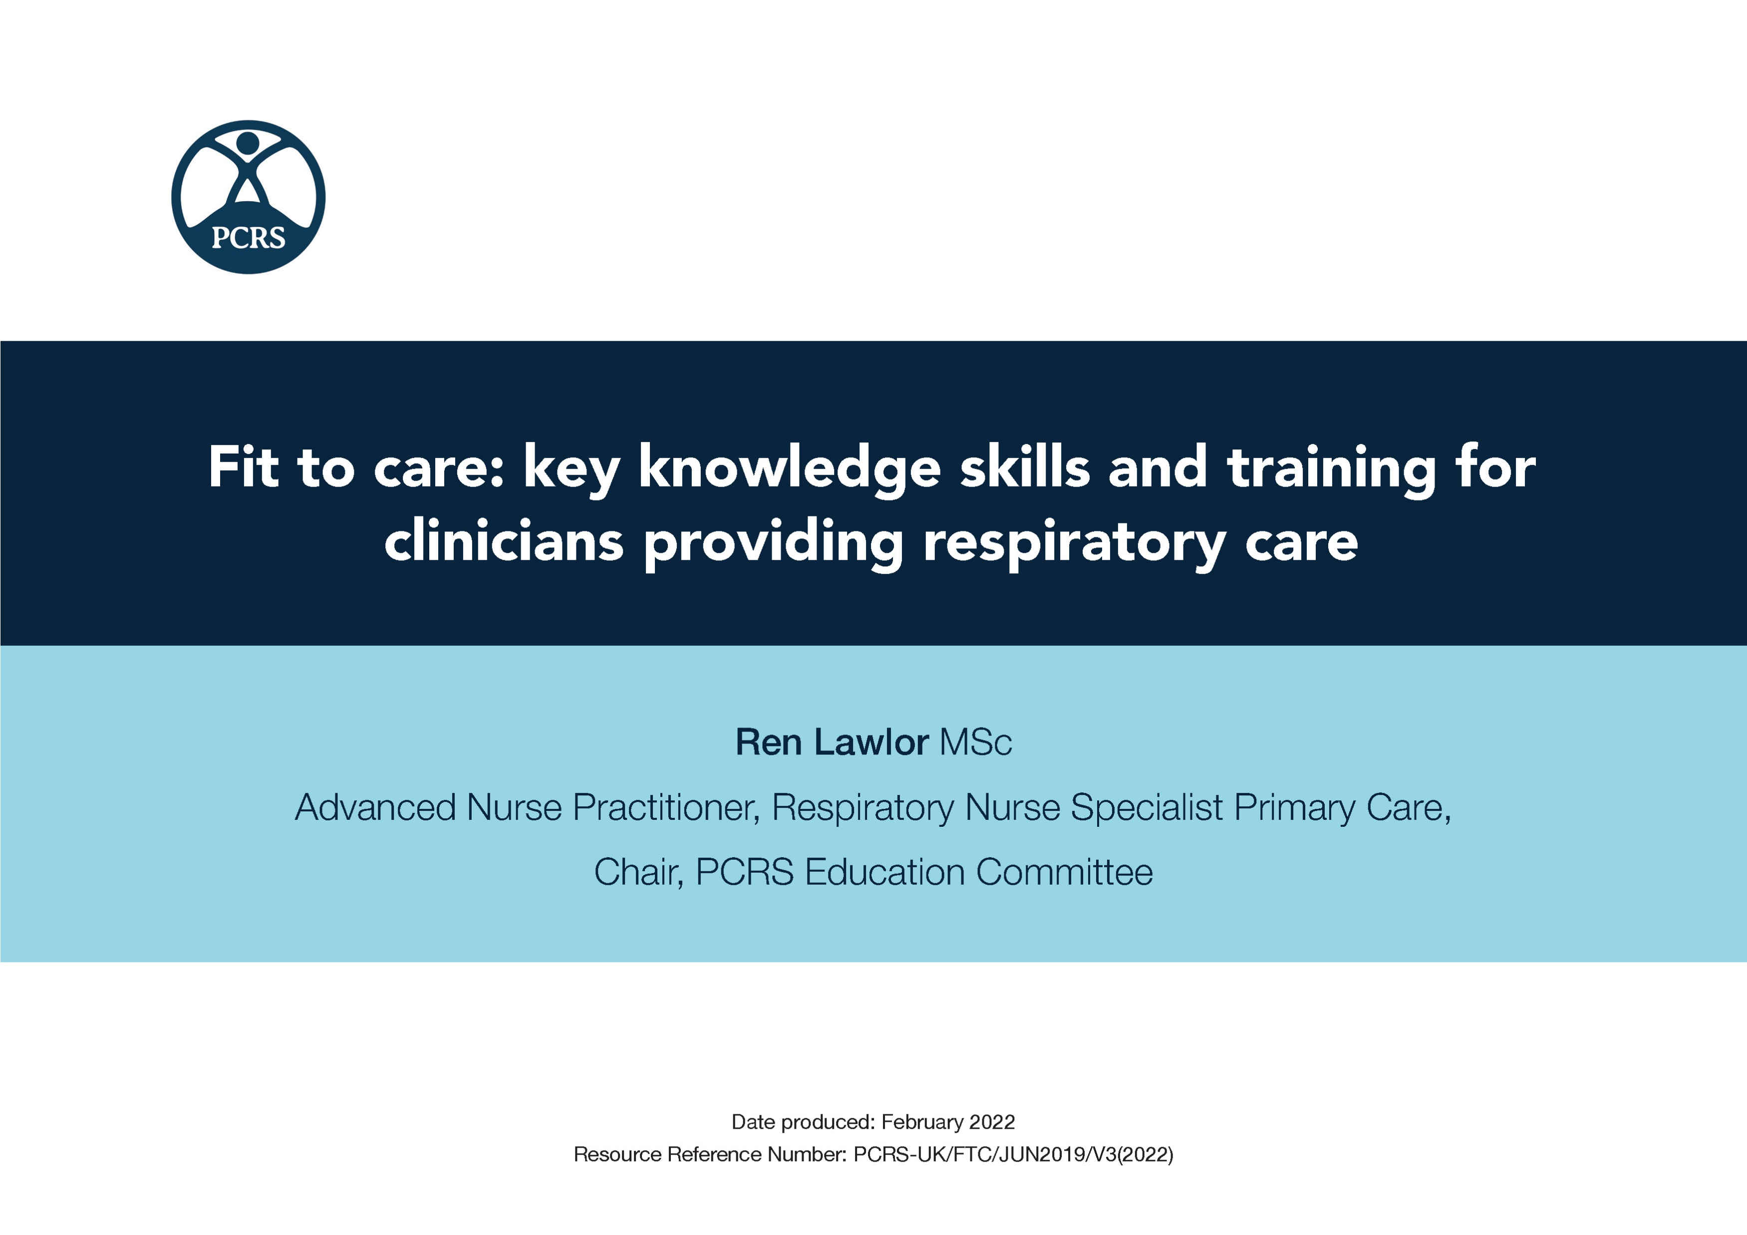


“ Variation in the level of training, education and experience of clinicians across the UK”
The aim of the PCRS Fit to Care document is to provide guidance to commissioners and clinicians on the skills, knowledge and training required by health care professionals to treat and manage asthma effectively for ALL patients.
“ Variation in the standard of respiratory care provided to patients”
Notes:
References = 1. Asthma and Lung UK and 10. Royal College of Physicians. National Review of Asthma Deaths: Why Asthma Still Kills. 2014

Slide 17


Invest in primary care respiratory services
Invest in testing
Invest in education
Invest
to save

Slide 18



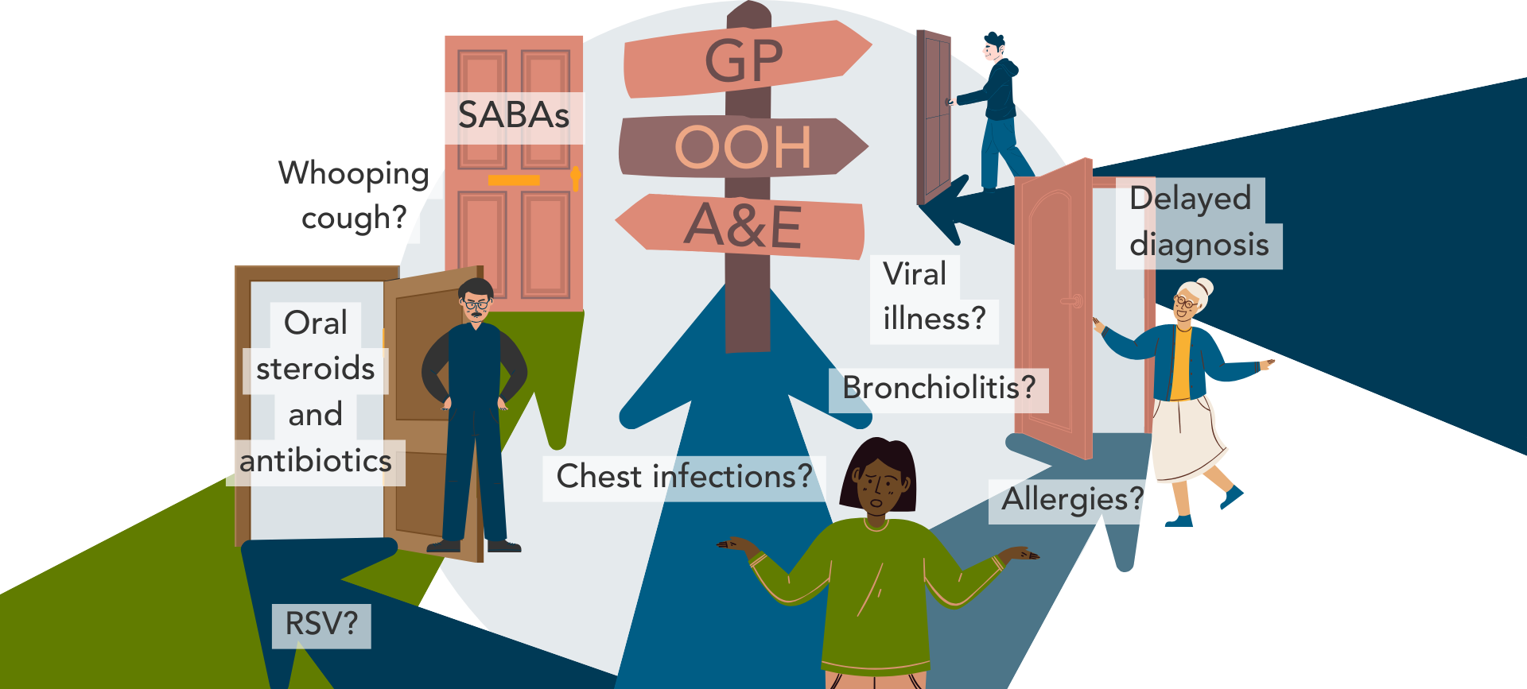



Reduce avoidable asthma deaths
Supporting early & accurate diagnosis
Reduce avoidable hospital admissions
Reduce overarching healthcare costs
Reduce inappropriate prescribing and associated risks and costs
Reduce unscheduled GP visits

Slide 19

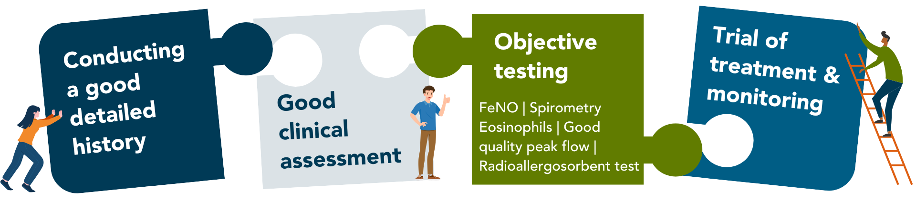

Asthma
Diagnosis
ICPRG jigsaw: www.ipcrg.org/DTH15
Putting all the relevant pieces of the jigsaw together is the key to accurately diagnosing asthma
Notes:
Speaker notes:
FeNO – Fractional exhaled nitric oxide
RAST – Radioallergosorbent test

Slide 20
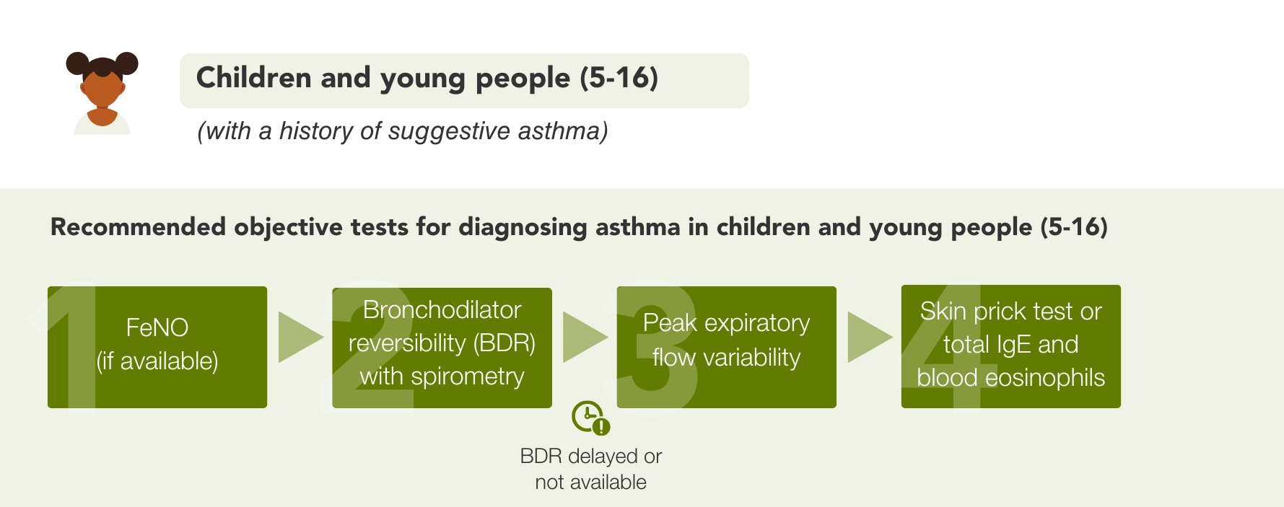
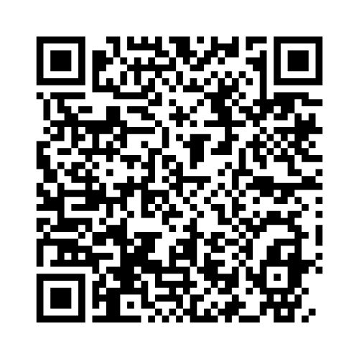
Confirming an asthma diagnosis
Scan the QR to access the diagnosing asthma in CYP position statement
Notes:
Reference = 2. BTS/NICE/SIGN asthma guideline 2024
NOTE: The Diagnosing Asthma in CYP position statement will be made publicly available in mid-late May 2025.

Slide 21
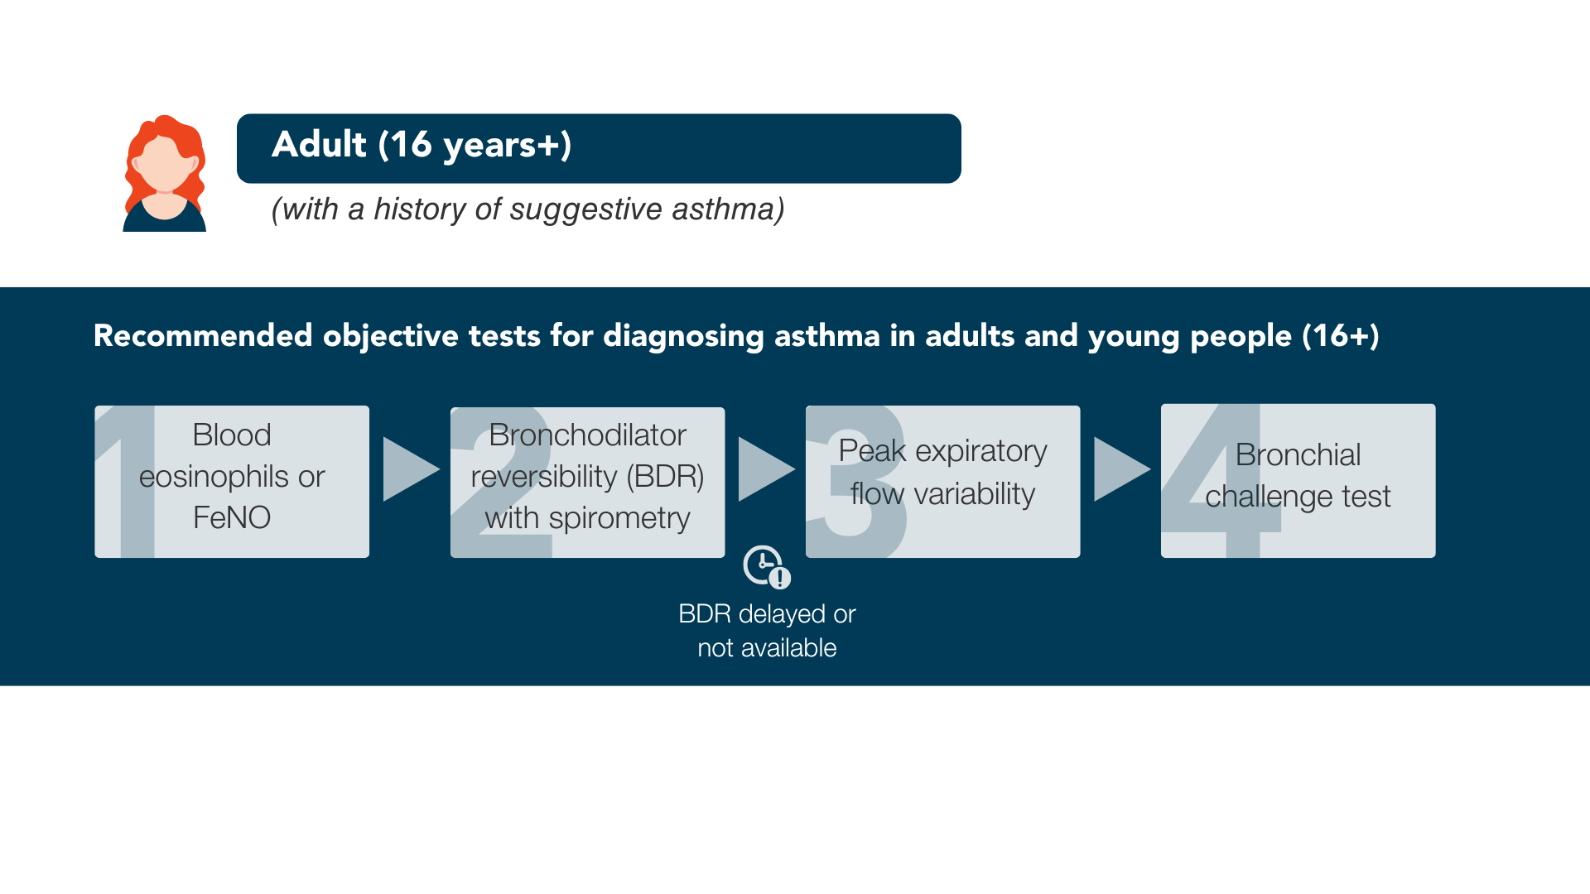
Confirming an asthma diagnosis
Notes:
Reference = 2. BTS/NICE/SIGN asthma guideline 2024

Slide 22

Getting the asthma treatment right

Slide 23
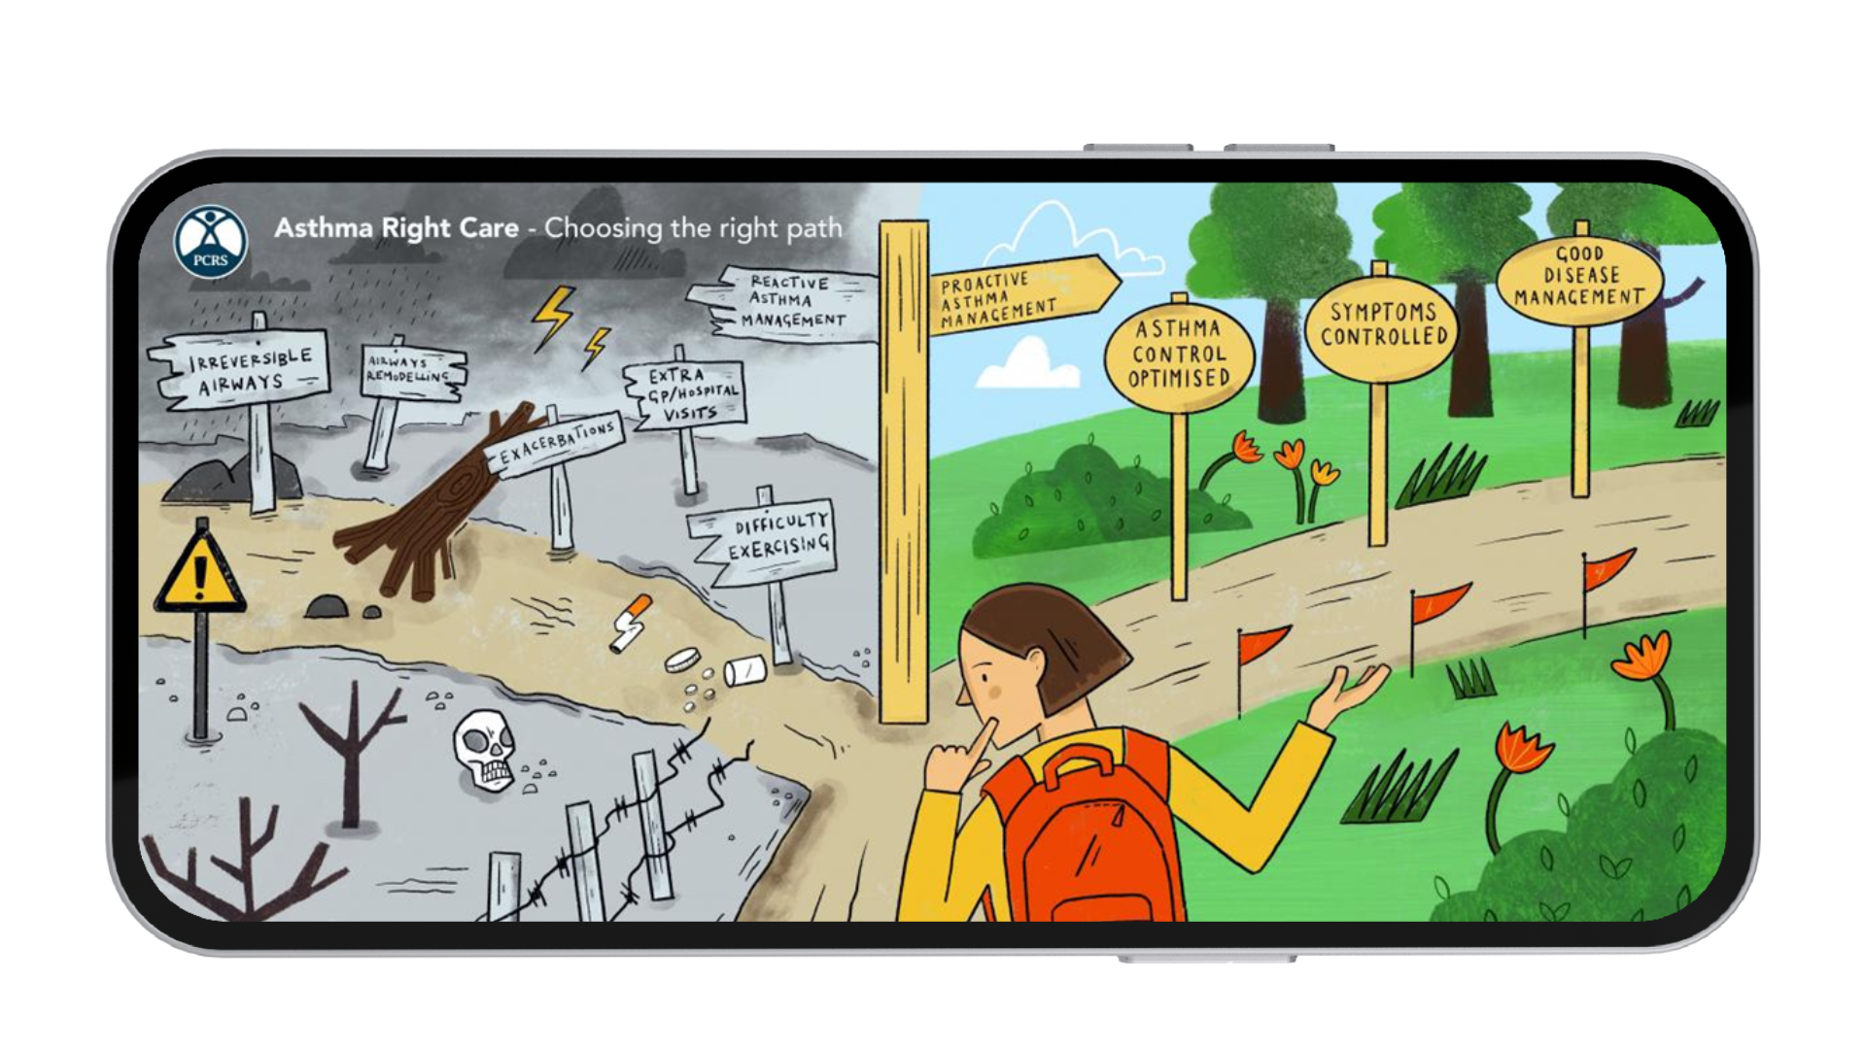
The right treatment pathway

Slide 24
Introduction to asthma treatment as per the new BTS/NICE/SIGN asthma guidelines
Pharmacological management highlights: SABA overuse and treatment by age groups.​
Anti-inflammatory reliever (AIR) therapy: Key innovations in treatment.​
Greener respiratory pathways: Sustainable practices.​
Supporting schools: Schools’ role in asthma care.​
Reducing inequalities: Addressing disparities.​
Key messages for successful adoption: Summary and takeaways
Notes:
Notes:
SABA = Short-acting beta-agonists
See slides 25-28 for more information on SABA.
Reference = 2. BTS/NICE/SIGN asthma guideline 2024

Slide 25

SABA over-reliance (≥3 inhalers/year) is associated with poorer patient outcomes and an increase in exacerbations¹
Approximately twice as many exacerbations occur in patients who are prescribed ≥3 SABAs/year vs 0-2 SABAs/year. Despite this, in the UK, 38% of patients are still prescribed ≥3 SABAs/year¹
1.0
Mean number of exacerbations in the first year of follow-up by asthma severity (by BTS treatment step 1-5)¹
0.8
0.79
0.6
0.61
Mean Number of Exacerbations‡
0.4
0.41
0.37
0.29
0.2
0.21
0.22
0.2
0.12
0.09
0
No ICS
Low-dose ICS
Low-dose
ICS + LABA
Medium-dose ICS +/-
additional therapy
High-dose ICS +/-
additional therapy
Low SABA Use (0–2 year)
n=92,510
n=54,523
n=15,304
n=23,187
n=5,365
High SABA Use (≥3 year)
n=12,417
n=40,320
n=17,220
n=29,402
n=10,844
1. Figure adapted from Bloom CI, et al. 2020.
Notes:
Notes
Short-acting beta-agonists (SABA) are often (blue) reliever inhalers which are used by many individuals with asthma to deal with a sudden onset of more severe asthma symptoms. However, this medication does not treat the underlying lung inflammation this causes asthma. Inhaled corticosteroids (ICS) inhalers (typically known as brown inhalers) do this, but many individuals do not use these as prescribed (one or twice every day) and only rely on their reliever (blue) inhaler when they are symptomatic. This means that the main cause of asthma is not being treated, and they are therefore at a higher risk of worse symptoms, uncontrolled asthma, high prescription costs, requiring admission admissions or unscheduled GP visits and adverse outcomes due to their asthma. All SABA inhalers should be prescribed and used with an accompanying ICS inhaler.
LABA = Long-acting beta-agonists

Slide 26

Across all asthma severities, patients focus on immediate symptom relief, relying on SABA use instead of ICS¹
In a study of 2,803 patients with asthma, nearly two-thirds (63%) reported
using a reliever inhaler (SABA), while only 23% reported use of ICS¹
Note: The data presented below is from the AIRE study which published its results in 2000 and may not accurately reflect current patient behaviours
100
80
60
Patients (%)
40
20
0
Severe persistent
Moderate
persistent
Mild
persistent
Mild
Intermittent
Severe
persistent
Moderate
persistent
Mild
persistent
Mild
Intermittent
Children (n=753)
Adults (n=2,050)
SABA
ICS
1. Figure adapted from Rabe KF, et al. 2000.
Notes:
Notes
Short-acting beta-agonists (SABA) are often (blue) reliever inhalers which are used by many individuals with asthma to deal with a sudden onset of more severe asthma symptoms. However, this medication does not treat the underlying lung inflammation this causes asthma. Inhaled corticosteroids (ICS) inhalers (typically known as brown inhalers) do this, but many individuals do not use these as prescribed (one or twice every day) and only rely on their reliever (blue) inhaler when they are symptomatic. This means that the main cause of asthma is not being treated, and they are therefore at a higher risk of worse symptoms, uncontrolled asthma, high prescription costs, requiring admission admissions or unscheduled GP visits and adverse outcomes due to their asthma. All SABA inhalers should be prescribed and used with an accompanying ICS inhaler.

Slide 27

National Review of Asthma Deaths: SABA is over-prescribed whilst preventer medication is under-prescribed
The NRAD report was an investigation of asthma deaths in the UK by the Royal College of Physicians, and it was undertaken over a 3-year period. The aim was to understand the circumstances surrounding asthma deaths in the UK to identify avoidable factors and make recommendations to improve care and reduce the number of deaths
Evidence of excessive prescribing
of reliever medication (n=165)
Evidence of under prescribing
of preventer medication (n=128)
39%
12
To comply with recommendations, most patients would usually need at least 12 preventer prescriptions per year
38%
4
of patients who were on short-acting relievers* at the time of death had been prescribed more than
short-acting reliever inhalers in the year before they died…(65/165)
of patients on preventer inhalers* received fewer than
inhalers in the year leading up to their death… (49/128)
>50
80%
SABA inhalers prescribed to 4%
of patients
received fewer than 12
preventer inhalers
Notes:
Notes
Study details: NRAD 2014 – Asthma deaths occurring between February 2012 and January 2013 were identified through the Office for National Statistics (ONS) for England and Wales, the Northern Ireland Statistics and Research Agency (NISRA) and the National Records of Scotland (NRS). Extensive information about each death was sought from multiple sources, including primary, secondary and tertiary care, as well as ambulance, paramedic and out-of-hours care providers. 374 local coordinators were appointed in 297 hospitals across the NHS to collect and submit information to the project team, and 174 expert clinical assessors were recruited from primary, secondary and tertiary care throughout the UK to join expert panels that reviewed data. Each assessor participated in one or more expert panels, during which all information gathered on each death, including post-mortem reports, was reviewed by two assessors in detail, and this was followed by discussion and a consensus agreement of avoidable factors and recommendations by the whole panel.
Data were available for analysis on 195 people who were thought to have died from asthma during the review period and the key findings relate to this group. Denominators vary according to where data were missing.
SABA
Short-acting beta-agonists (SABA) are often (blue) reliever inhalers which are used by many individuals with asthma to deal with a sudden onset of more severe asthma symptoms. However, this medication does not treat the underlying lung inflammation this causes asthma. Inhaled corticosteroids (ICS) inhalers (typically known as brown inhalers) do this, but many individuals do not use these as prescribed (one or twice every day) and only rely on their reliever (blue) inhaler when they are symptomatic. This means that the main cause of asthma is not being treated, and they are therefore at a higher risk of worse symptoms, uncontrolled asthma, high prescription costs, requiring admission admissions or unscheduled GP visits and adverse outcomes due to their asthma. All SABA inhalers should be prescribed and used with an accompanying ICS inhaler.
https://www.asthmaandlung.org.uk/media/press-releases/one-million-people-uk-risk-asthma-attack-because-they-could-be-relying-wrong
Reference = 10. Royal College of Physicians. National Review of Asthma Deaths: Why asthma still kills. 2014.

Slide 28

Asthma slide rule
PCRS has collaborated with Astra Zeneca Ltd to produce a tool which supports healthcare processionals with assessing the risk of SABA use in individuals with asthma.
Scan the QR code to access the slide rule.
This resource has been produced as part of the PCRS Asthma Right Care (ARC) initiative, which is part of a wider global social movement initiated by the IPCRG; AstraZeneca Ltd has sponsored the production of this resource, the sponsor has had no input into the resource content.
Notes:
SABA = Short-acting beta-agonists

Slide 29
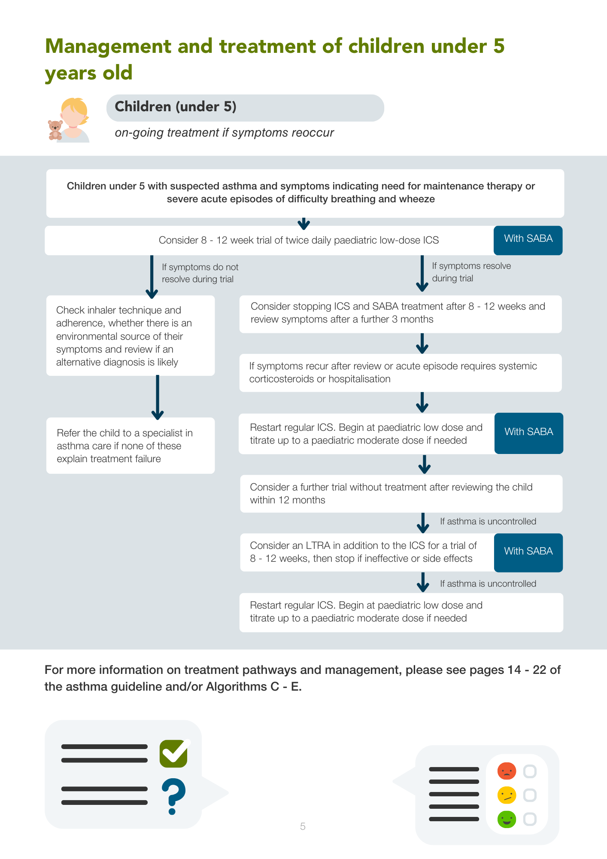
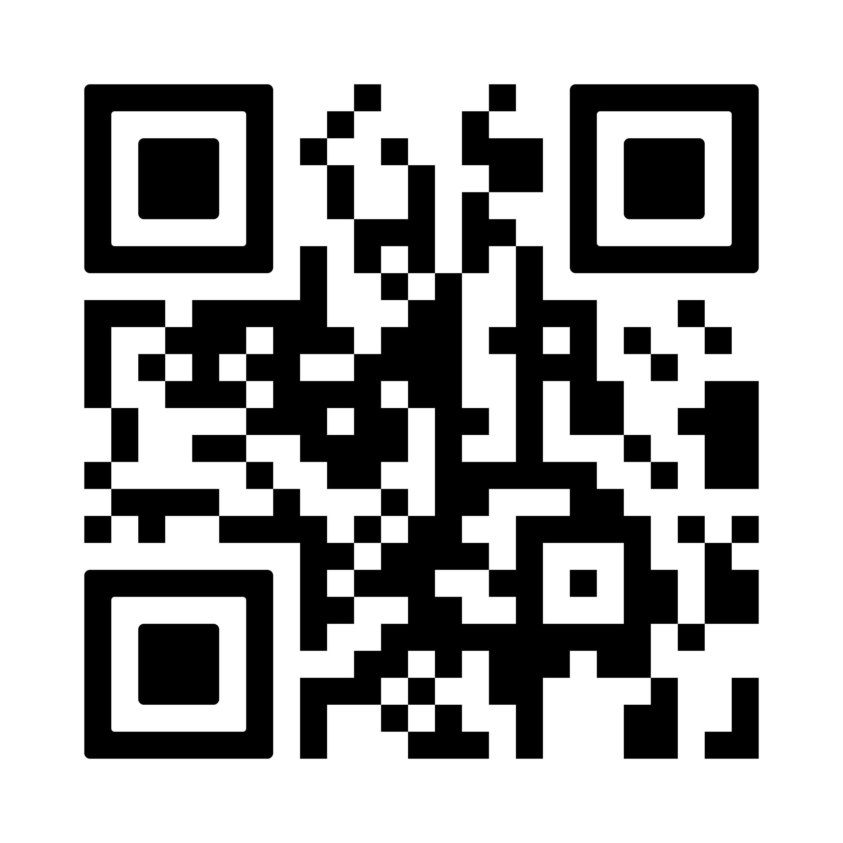
Management and treatment of children under 5 years old
Consider and try to address the possible reasons for uncontrolled asthma before starting or adjusting medications for asthma. For example: alternative diagnoses or comorbidities; suboptimal inhaler technique; passive smoking (including e-cigarettes); seasonal factors; environmental factors (such as air pollution and indoor mould exposure)
Uncontrolled asthma: Any exacerbation requiring oral corticosteroids or frequent regular symptoms (such as using reliever inhaler 3 or more days a week or night-time waking 1 or more times a week)
Scan the QR code to access our guideline.
Notes:
Speaker notes:
ICS = Inhaled cortico-steroids
SABA = Short-acting beta-agonists
LTRA = Leukotriene receptor antagonists
Reference = 2. BTS/NICE/SIGN asthma guideline 2024

Slide 30
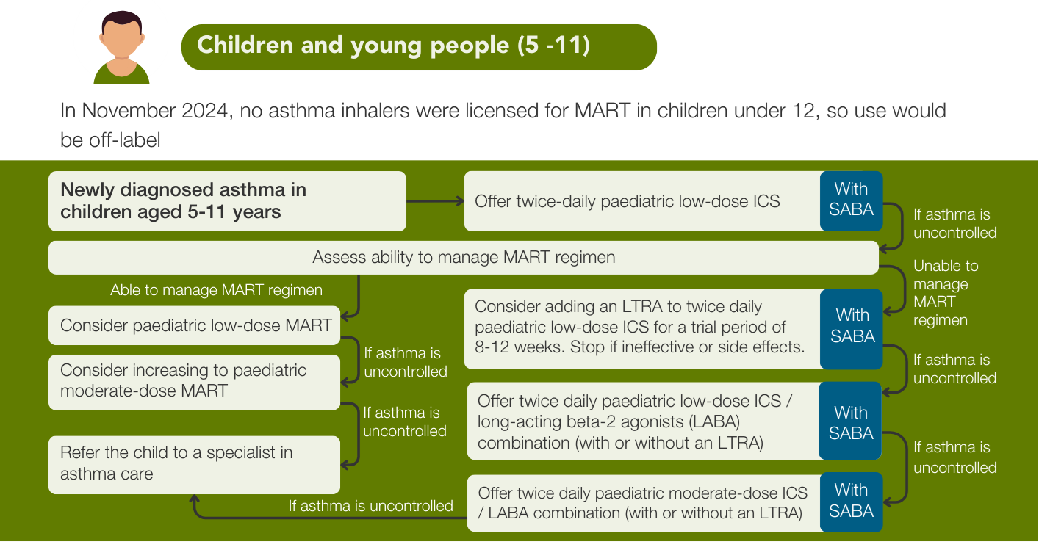
Treatment for people newly diagnosed with asthma (5-11 years)
Early inhaled corticosteroids!!
MART now features in 5-11 years pathway
MART, based on a single study, outperformed both moderate-dose ICS plus SABA and low-dose ICS/LABA plus SABA in reducing exacerbations, reliever inhaler use, and adverse events.
Economic analysis also showed that MART was cost-effective, offering more QALYs and lower costs than the other treatment options.
The comparison between low-to-moderate dose ICS plus SABA and low-dose ICS/LABA showed fewer exacerbations with the former, but more hospital admissions.
Notes:
Speaker notes:
MART – Maintenance and reliever therapy
ICS = Inhaled cortico-steroids
LTRA = Leukotriene receptor antagonists
LABA = Long-acting beta-agonists
QALYS = Quality-adjusted life year (a measure of health outcomes that combines both the length and quality of life, used in healthcare economics to assess the value of treatments and interventions).
Reference = 2. BTS/NICE/SIGN asthma guideline 2024
To access the full PCRS resource on this, please go to: https://www.pcrs-uk.org/resource/current/first-steps-implement-new-btsnicesign-asthma-guideline

Slide 31
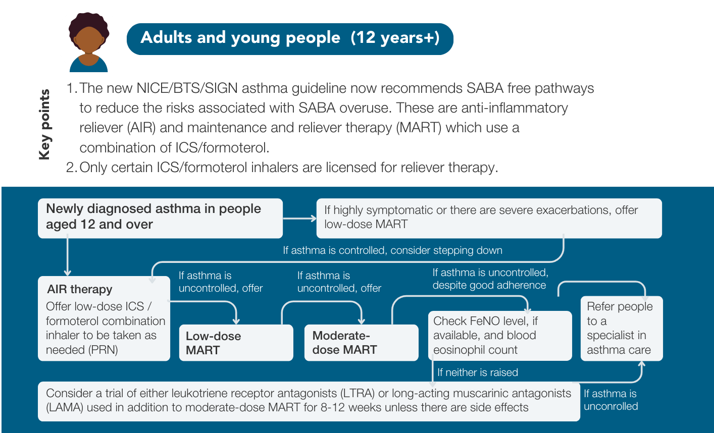
Treatment for people newly diagnosed with asthma (12 years+)
A SABA free single-track approach
Notes:
Speaker notes:
SABA = Short-acting beta-agonist
MART – Maintenance and reliever therapy
ICS = Inhaled cortico-steroids
PRN = Daily
FeNO = Fractional exhaled nitric oxide
LTRA = Leukotriene receptor antagonists
LAMA = Long-acting muscarinic antagonists
Low dose MART strengths for 12+ years
- Low does up to 400mcg budesonide (in single or divided doses) – fine particle beclometasone can be considered for MART in 18+
- Moderate-dose = up to 800mcg budesonide (in single or divided doses) - fine particle beclometasone can be considered for MART in 18+
Reference = 2. BTS/NICE/SIGN asthma guideline 2024
To access the full PCRS resource on this, please go to: https://www.pcrs-uk.org/resource/current/first-steps-implement-new-btsnicesign-asthma-guideline

Slide 32
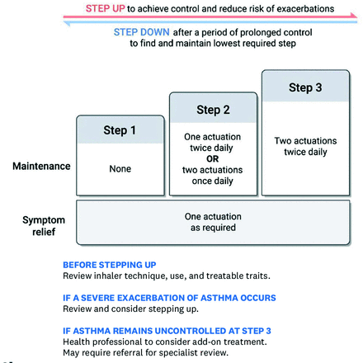
A simple and effective evidence-based approach to asthma management
Anti-inflammatory reliever (AIR) therapy
Treatment with a reliever inhaler that contains a combination of an inhaled corticosteroid and formoterol. When this is used in response to symptoms without regular maintenance therapy it is called as-needed AIR therapy.
In November 2024 the only product licensed for as-needed AIR therapy contained budesonide/formoterol.
Notes:
Reference = 2. BTS/NICE/SIGN asthma guideline 2024
To access the full PCRS resource on this, please go to: https://www.pcrs-uk.org/resource/current/first-steps-implement-new-btsnicesign-asthma-guideline

Slide 33


AIR/MART benefit- think TRAMS
Treatment consistency from ≥12 years
MART standardisation for ages 12+ ensures uniform asthma management.
Risk reduction
MART therapy decreases severe asthma attacks and hospital visits with one inhaler.
Asthma control
MART promotes the lowest effective ICS dose, minimizing long-term corticosteroid risks.
Measurable cost savings
MART lowers exacerbations and healthcare costs.
Simplified management
One inhaler improves adherence by eliminating multiple inhalers.
Notes:
Speaker notes:
AIR – Anti-inflammatory reliever
MART = Maintenance and reliever therapy
ICS = Inhaled cortico-steroids
AIR vs SABA alone reduced severe exacerbations by 55%​
AIR vs SABA alone reduced Urgent & Emergency Care usage by 65%
References:
https://www.nice.org.uk/guidance/ng245/resources/inhaled-corticosteroid-doses-for-the-bts-nice-and-sign-asthma-guideline-pdf-13558148029
https://www.cochrane.org/CD013518/AIRWAYS_combination-fixed-dose-beta-agonist-and-steroid-inhaler-required-adults-or-children-mild-asthma

Slide 34
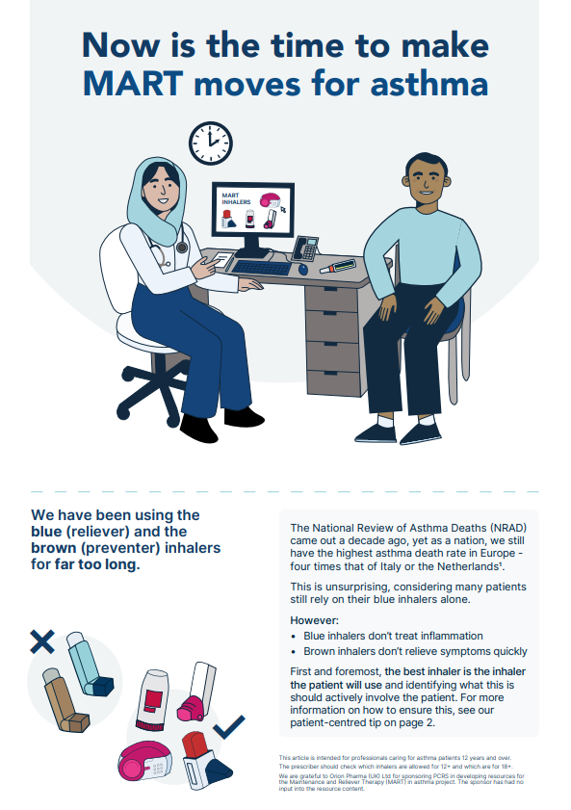
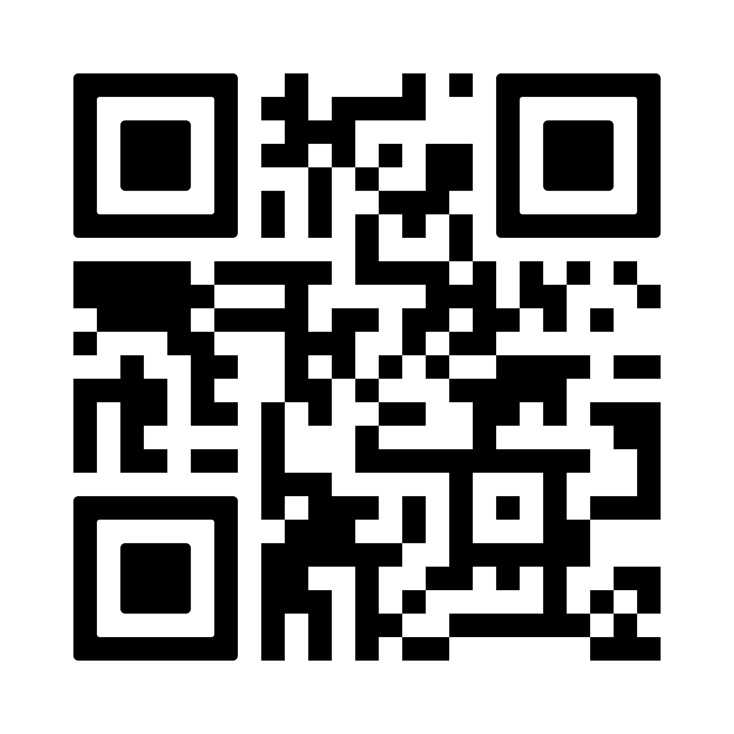
Treatment: AIR and MART (ICS/LABA)
Reduced exacerbations and hospital admissions: MART (ICS/LABA) therapy reduces severe asthma attacks and hospital admissions by combining maintenance and reliever therapy in a single inhaler​​.
Cost-effective: MART is a cost-effective approach, leading to fewer exacerbations and healthcare visits, ultimately saving costs​​.
Simplified treatment: Single-inhaler MART simplifies management, improving adherence by reducing the need for multiple inhalers​​.
Consistent guidelines across ages: Standardised MART use for ages 12+ aligns treatment approaches, ensuring consistent asthma management across age groups​.
Long-term health benefits: Encourages the lowest effective dose of ICS, reducing risks associated with long-term corticosteroid use​.
Scan the QR code to view the PCRS MART top tips article.
Notes:
Speaker notes:
AIR – Anti-inflammatory reliever
MART = Maintenance and reliever therapy
LABA = Long-acting beta-agonist
ICS = Inhaled corticosteroid

Slide 35
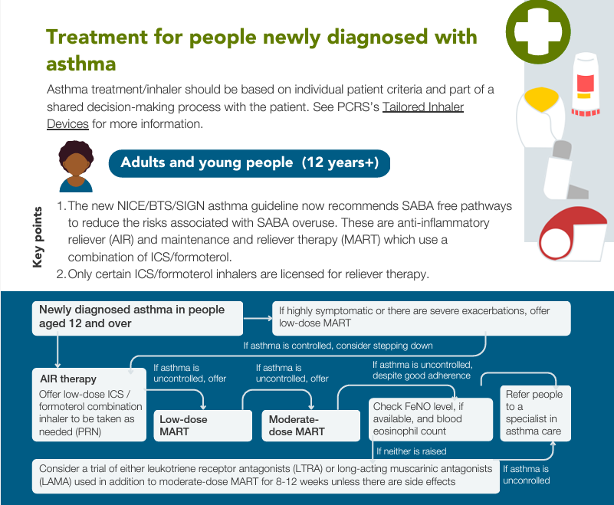
Educational tools support guideline implementation
Notes:
Speaker notes:
SABA = Short-acting beta-agonist
MART – Maintenance and reliever therapy
ICS = Inhaled cortico-steroids
PRN = Daily
FeNO = Fractional exhaled nitric oxide
LTRA = Leukotriene receptor antagonists
LAMA = Long-acting muscarinic antagonists
Reference = 2. BTS/NICE/SIGN asthma guideline 2024
To access the full PCRS resource on this (and links shown in image), please go to: https://www.pcrs-uk.org/resource/current/first-steps-implement-new-btsnicesign-asthma-guideline

Slide 36
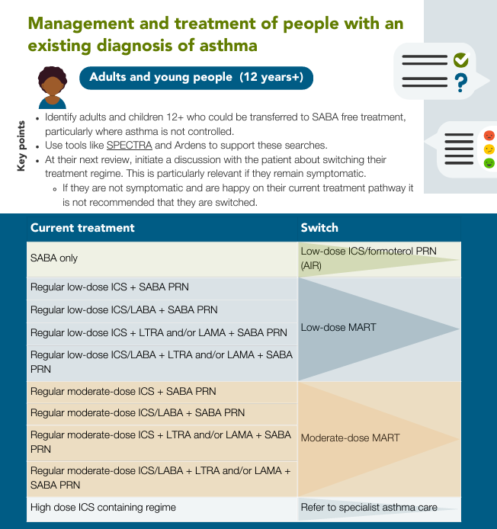
Stepping down TIPS
(adults and young people 12+)
Consider reducing asthma therapy if:
Asthma is well controlled for 3 months.
- Discuss the risks and benefits of this change, factoring in the treatment's effectiveness, side effects, and the individual’s preferences.
- If stepping down from low-dose ICS or low-dose MART, switch to low-dose ICS/formoterol as needed.
- Establish a plan for self-monitoring and follow-up, and update the PAAP
Notes:
Notes
AIR – Anti-inflammatory reliever
MART = Maintenance and reliever therapy
ICS = Inhaled corticosteroid
SABA – Short-acting beta-agonist
PRN = daily
LABA = Long-acting beta-agonists
LTRA = Leukotriene receptor antagonists
LAMA = Long-acting muscarinic antagonists
PAAP = Personalised asthma action plan
Reference = 2. BTS/NICE/SIGN asthma guideline 2024
To access the full PCRS resource on this (and links shown in image), please go to: https://www.pcrs-uk.org/resource/current/first-steps-implement-new-btsnicesign-asthma-guideline

Slide 37
Supporting the development of local guidelines
Effective step-up therapy
Local guidelines help ensure appropriate adjustments in ICS/LABA treatment, progressing from low to moderate doses based on patient response, reducing the risk of exacerbations​.
Improved device use
Standardising inhaler types for both maintenance and reliever therapy simplifies device use, helping patients manage asthma more effectively​.
Consistent treatment pathways
Local guidelines support structured treatment pathways across patient age groups, including specialised management for children, young people, and adults​.
Short videos on minimising MDI’s and switching to DPIs - www.pcrs-uk.org/greener-healthcare/webinars-and-videos
Personalised treatment options
Recommend personalising asthma therapy (e.g., using LTRA and LAMA as needed), ensuring treatment aligns with individual needs/ improving outcomes​.
Notes:
Notes
LABA = Long-acting beta-agonists
LTRA = Leukotriene receptor antagonists
LAMA = Long-acting muscarinic antagonists
MDI = Metered-dose inhalers
DPI = Dry powder inhalers

Slide 38
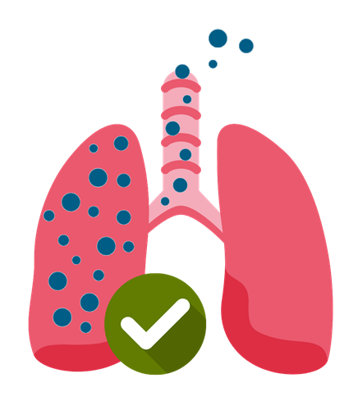
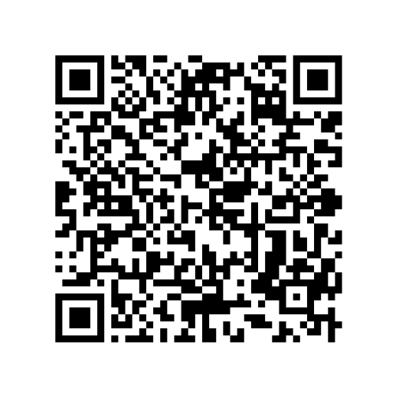
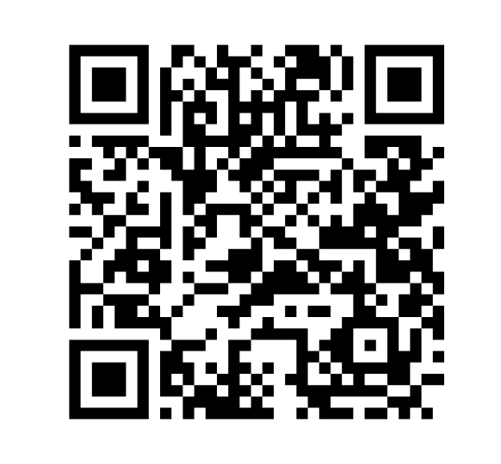
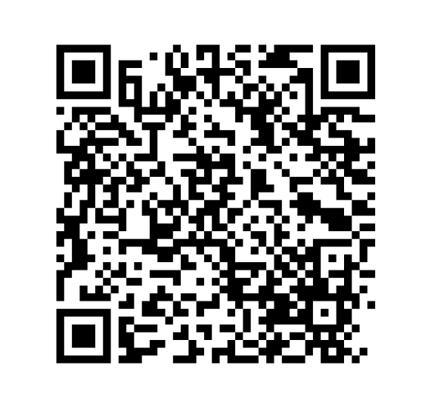
Risks of blanket switches of inhaler types
Adherence issues: Patients may struggle to adjust to new inhaler types, leading to lower adherence and poorer asthma control​.
Technique challenges: Switching to unfamiliar devices can cause technique errors, reducing medication effectiveness​.
Patient preference: Inhaler choice should consider patient comfort with the device; the best inhaler is the one they will reliably use​.
Environmental and health impact: Select inhalers based on both environmental impact and patient suitability to balance sustainability with effective asthma management​.
The best/greenest inhaler is the one the patient will use
Greener Respiratory Pathway (Maintenance and comorbidities
Short videos on minimising MDI’s and switching to DPIs
‘Blanket’ switching of inhaler types: Why is this a bad idea? -
PCRS resources to support you in this area:
Notes:
Notes
MDI = Metered-dose inhalers
DPI = Dry powder inhalers

Slide 39
Addressing health inequalities in asthma treatment
Risk-stratified approach
Identifies high-risk patients (e.g., poor adherence, SABA overuse) for targeted care.
Proactive alerts
GP systems flag at-risk patients to ensure timely interventions.
Cost-effective strategy
Reduces hospitalisations, emergency and unscheduled GP visits, focusing resources on those with greater needs.
Environmental impact
Good asthma care is sustainable asthma care.
Tailored Care
Ensures equitable treatment access and improves outcomes across diverse patient populations.
Notes:
Notes:
SABA – Short-acting beta-agonist

Slide 40
Reducing inequalities: Addressing disparities
Key recommendations (2024 Guidelines)
Access to diagnosis & treatment (Objective testing for asthma diagnosis)
  Ensure FeNO, spirometry, and peak flow (PEF) testing in primary care.
  Prioritise ICS (preventer) inhalers to reduce SABA overuse.
  Expand specialist asthma clinics in underserved areas.
Tackling socioeconomic & ethnic disparities (Tailored asthma management & education)
  Remove healthcare access barriers with targeted interventions.
  Provide multilingual asthma resources and culturally and age tailored care.
  Strengthen community outreach and education.
Environmental improvements (Reducing risk factors)
  Improve housing conditions to minimise asthma triggers.
  Implement clean air initiatives in high-risk areas.
  Support asthma-friendly policies in schools and workplaces.
Notes:
Speaker notes:
FeNO – Fractional exhaled nitric oxide
ICS = Inhaled corticosteroid
SABA – Short-acting beta-agonist
Reference = 2. BTS/NICE/SIGN asthma guideline 2024

Slide 41
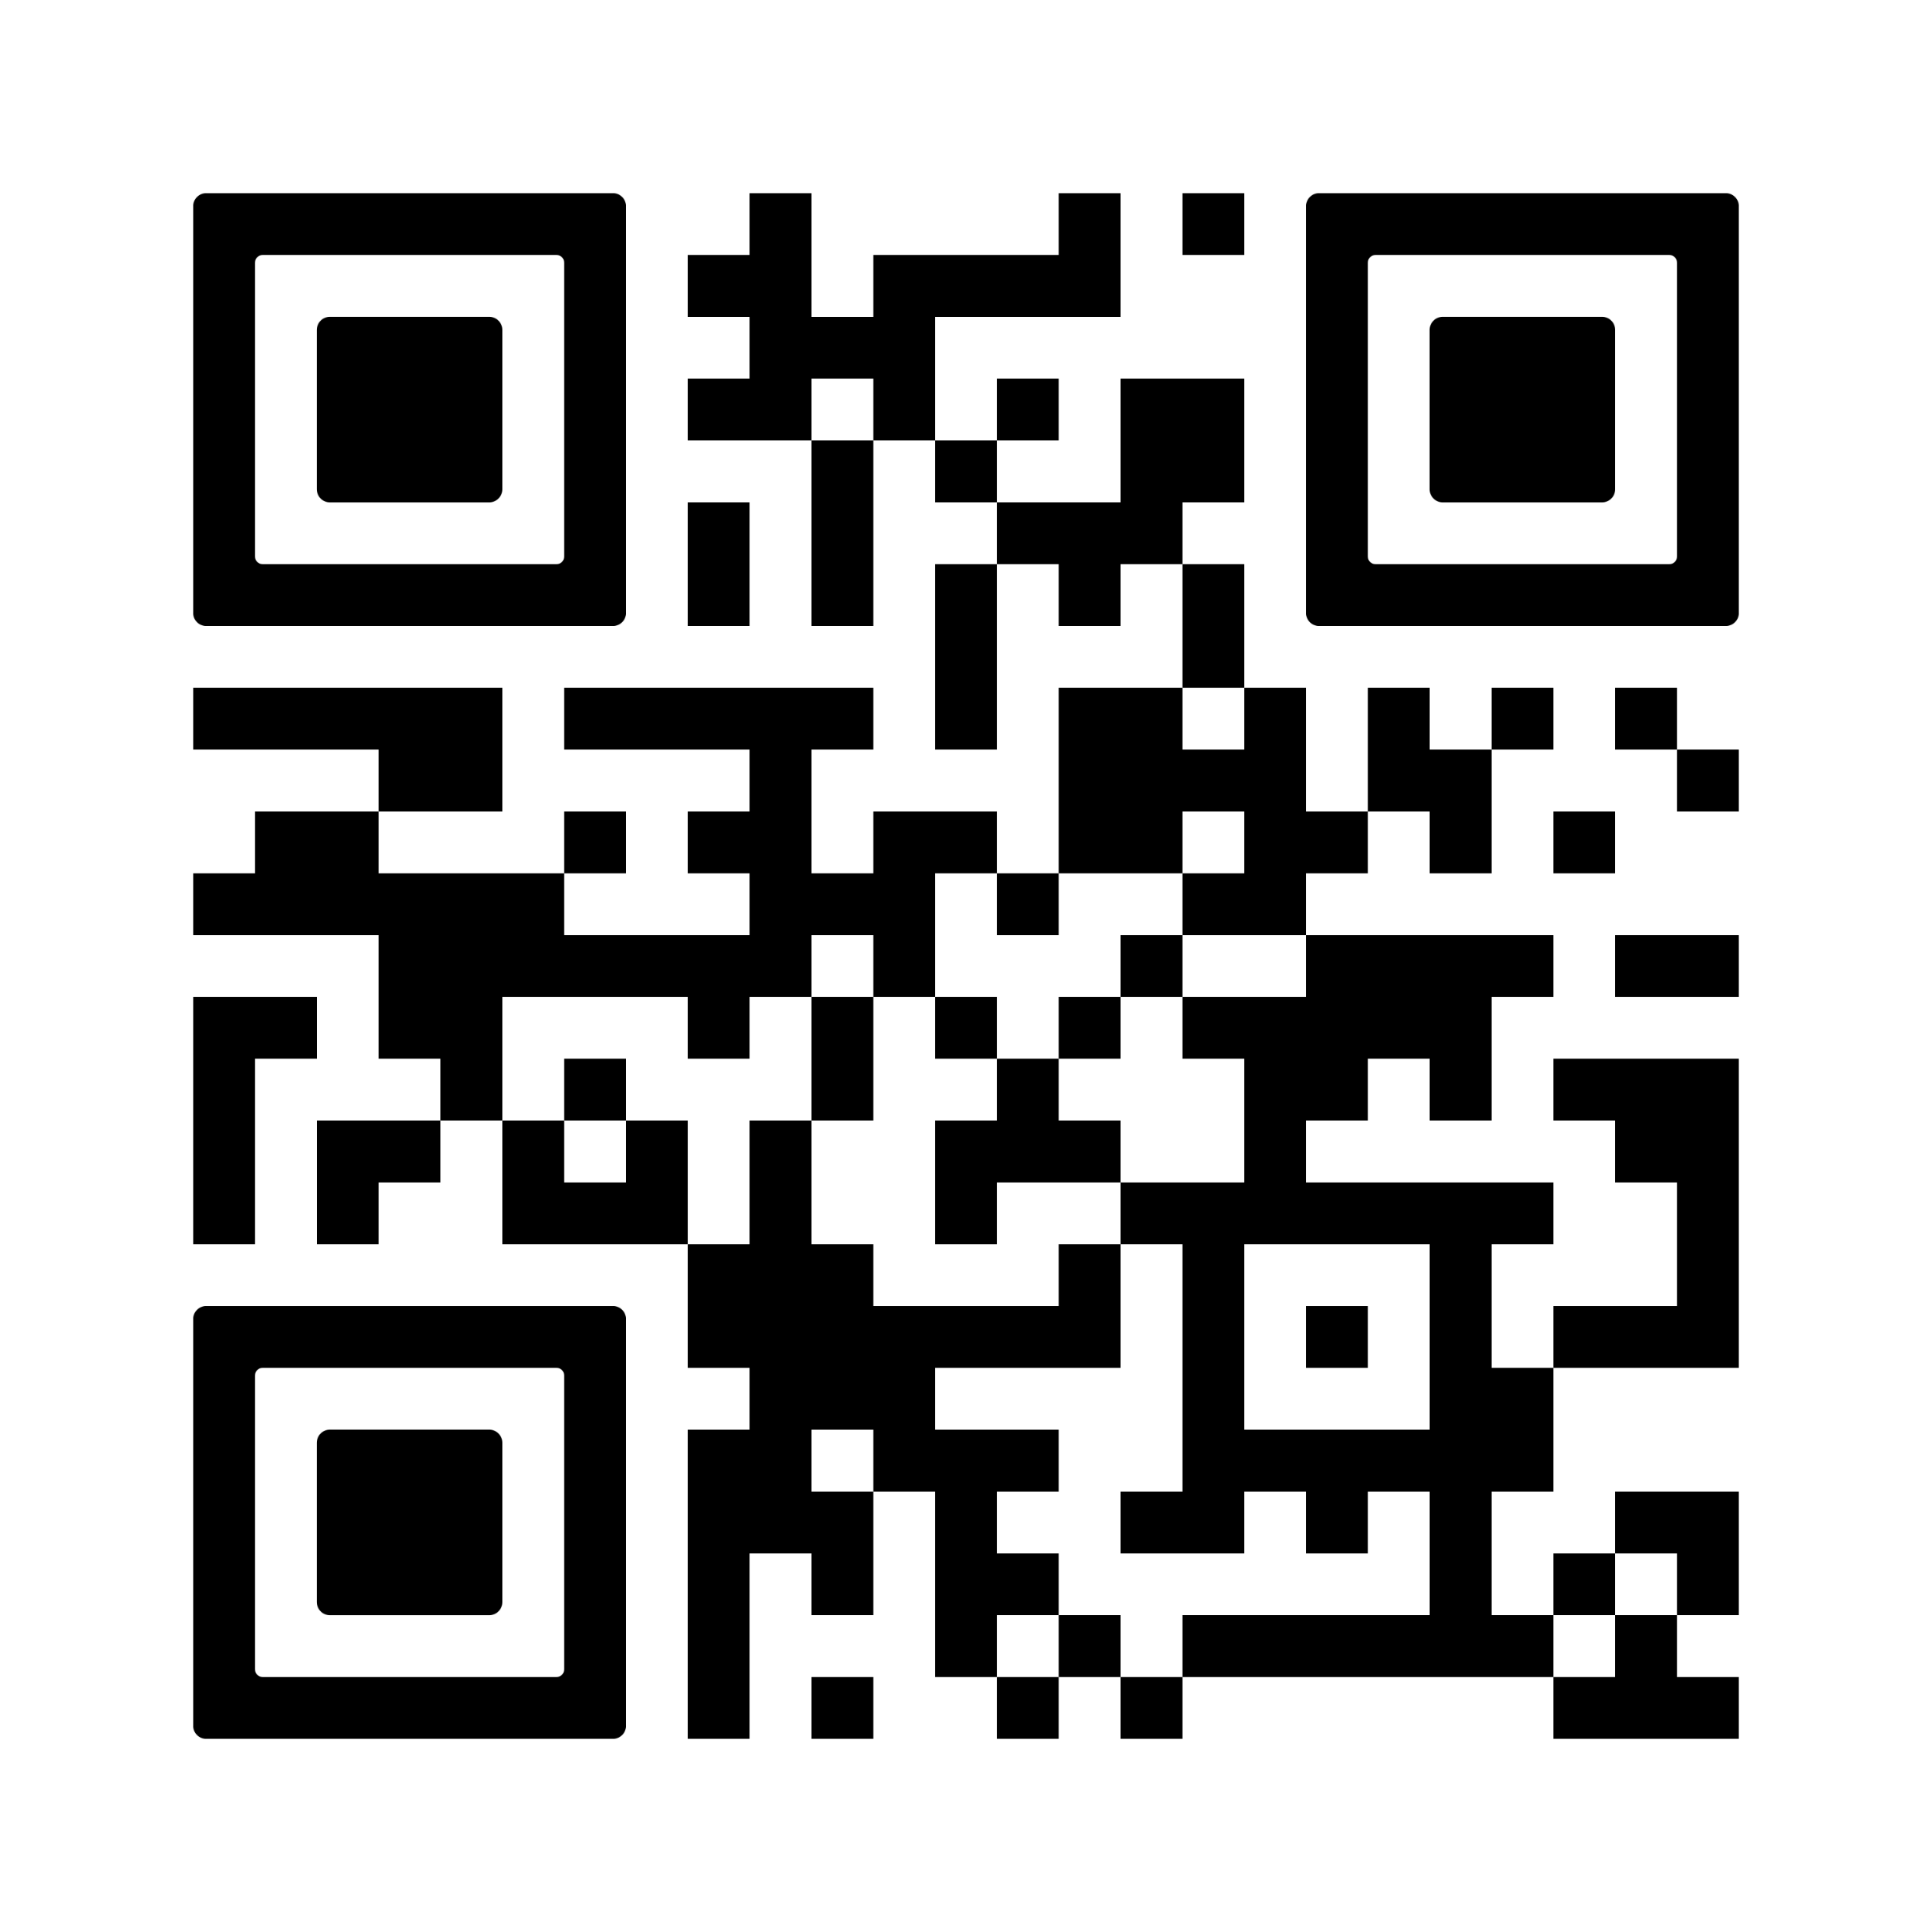
Reducing Inequalities: Addressing disparities
Enhancing self-management & education (Encouraging adherence)
  Train healthcare teams in inclusive asthma care.
  Promote Personalised Asthma Action Plans (PAAPs).
  Use telehealth and digital reminders for medication adherence.
Monitoring & evaluating impact (Proactive risk management)
  Reduce emergency admissions with better monitoring.
  Promote ICS-based treatments over SABA reliance.
  Enhance patient-reported asthma control & quality of life.
Alignment with ICB/Health board/Trust priorities (Integrating guidelines into local strategies)
  Implement evidence-based asthma management.
  Support community-driven solutions to disparities.
  Embed guidelines into local ICB/Health board respiratory strategies.
Scan the QR to visit the PCRS Health Inequalities Hub
Notes:
Notes:
ICS = Inhaled corticosteroid
SABA – Short-acting beta-agonist

Slide 42
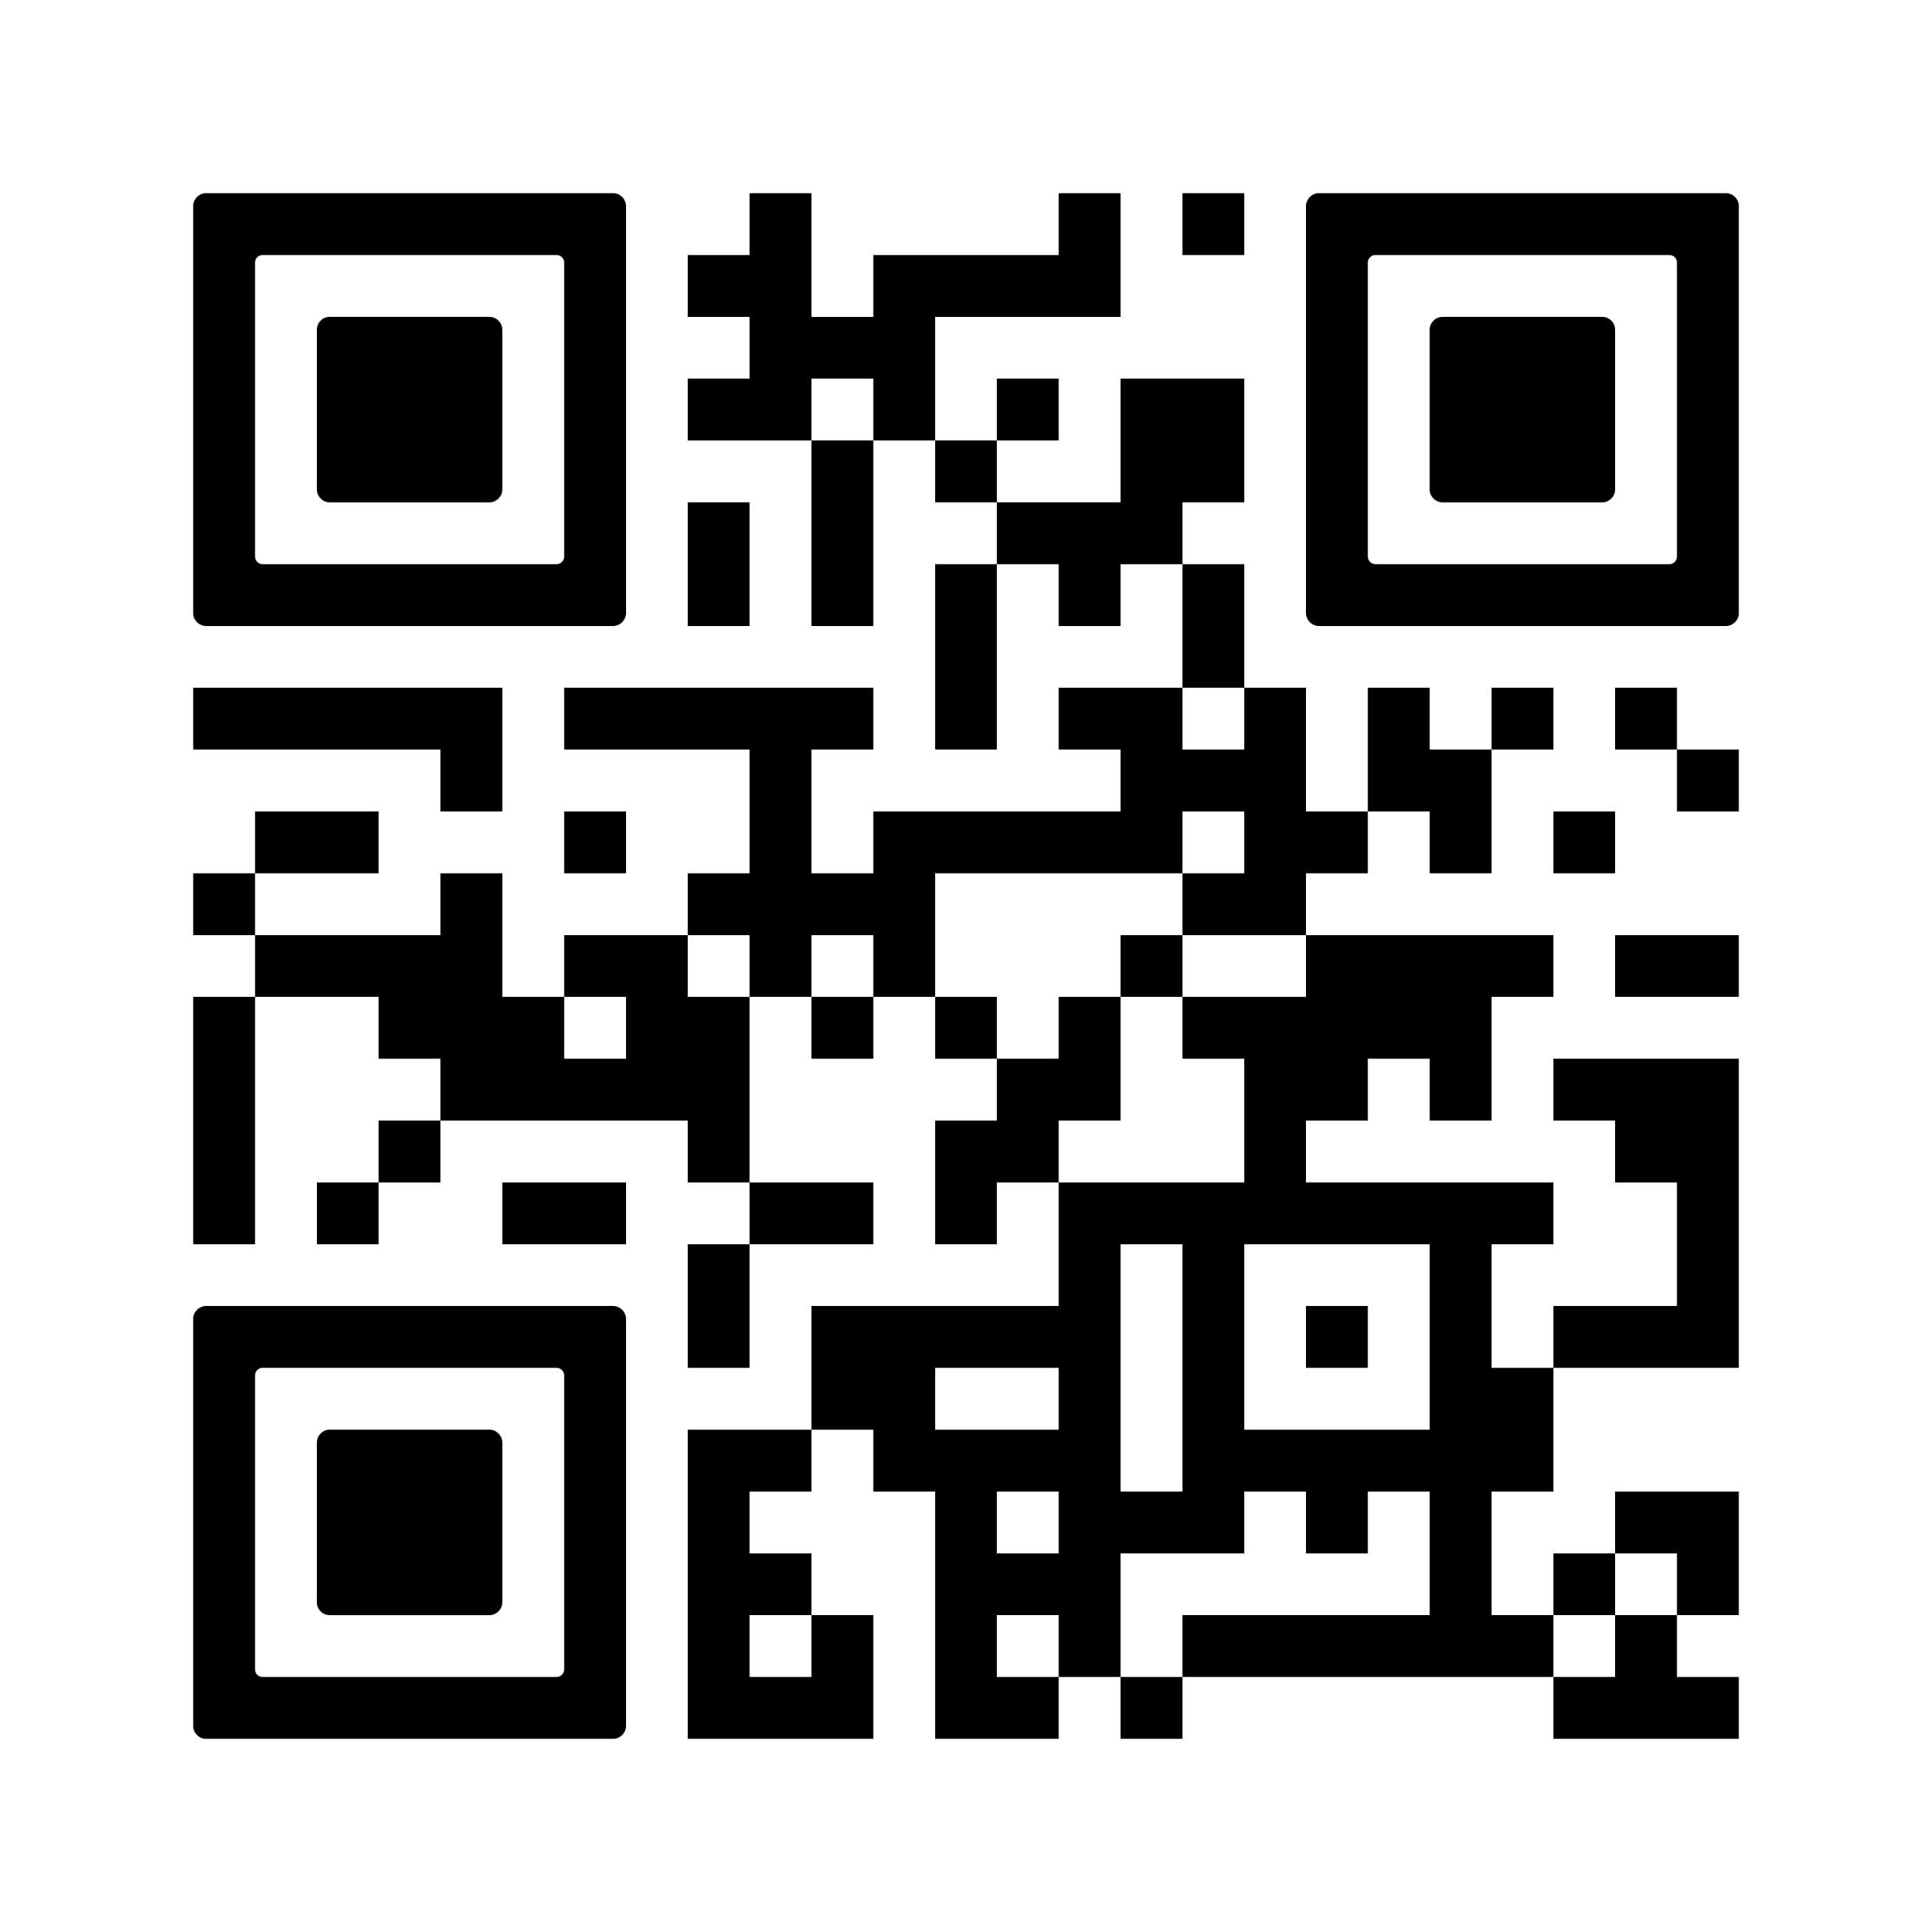
Encouraging environmentally sustainable practices
Individualised inhaler choices:
Consider suitability of dry powder inhalers (DPIs) where appropriate to reduce environmental impact.
Balance sustainability and adherence:
Ensure treatment choices are both sustainable and suitable for patient adherence.
Educational resources:
Provide accessible resources for healthcare professionals and patients.
Integration with strategies:
Align greener pathways with local and national sustainability goals.
Scan the QR to visit the PCRS Greener Healthcare Hub

Slide 43
Risks of SABA overuse in schools
Increased risk of exacerbations
Over-reliance on SABA (blue inhalers) can lead to poorly controlled asthma and more severe attacks.
Hospitalisation risks
Frequent SABA use without preventive therapy raises the likelihood of emergency visits and hospital admissions.
Importance of regular assessment
Children using SABA frequently should be evaluated to ensure optimal asthma management.
Encouragement of preventive measures
Use of ICS or MART as a preventive strategy is recommended to reduce SABA dependence.
Promoting asthma awareness in schools
Asthma-friendly schools:
Build networks to enhance safety and awareness within schools.
www.transformationpartners.nhs.uk/resource/london-asthma-toolkit/schools/asthma-friendly-schools/
Education for empowerment:
Provide tailored education for children, parents, and caregivers.
Sector collaboration:
Foster strong communication between healthcare providers, schools, and families
Emergency preparedness:
Ensure schools are equipped to manage asthma emergencies effectively.
Notes:
Speaker notes
MART = Maintenance and reliever therapy
ICS = Inhaled corticosteroid
SABA – Short-acting beta-agonist

Slide 44

Self-management

Slide 45
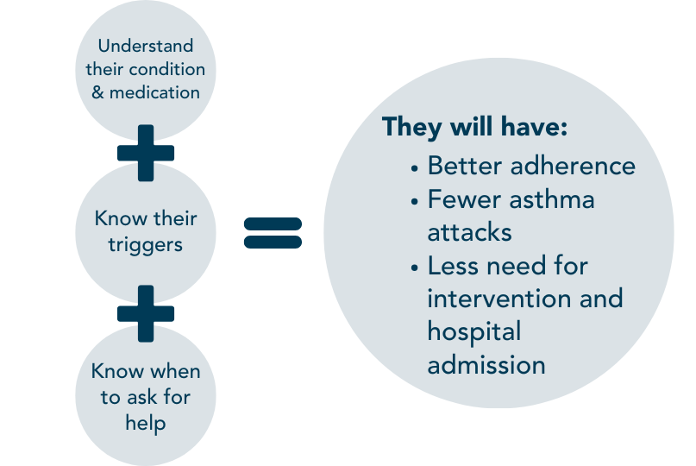

Self-management
Why is it important?
Effective self-management is providing ALL* people with asthma with the information, education and support they need to have agency and control of their own condition. If patients:
This will:
Reduce costs to the NHS
Address health inequalities
Reduce the adverse outcomes and death associated with asthma and bring us in line with Europe in this area of care
Support greener respiratory healthcare and NHS carbon emission targets
*Self-management programmes must be accessible to individuals of different abilities, ethnicities and backgrounds.
Notes:
References = 3. Clinical Knowledge Summaries: Asthma: https://cks.nice.org.uk/topics/asthma/ and 4. Cochrane Review: Personalised asthma action plans for adults with asthma: www.cochranelibrary.com/cdsr/doi/10.1002/14651858.CD011859.pub2/full?)

Slide 46
Self-management
What does the new asthma guideline say about
self-management that is relevant to your ICB/Health board/Trust?
Asthma self-management programmes, comprising a documented personalised action plan and education must be offered to all people with asthma and reviewed at hospital admissions, acute consultations and annual reviews.
*Self-management programmes tailored specifically to children and young people should be available*
Strategies and the availability of specialists for advice should be in place to ensure access to support and information across the primary care spectrum.
Schools and health services should collaborate to provide in-school asthma self-management education programmes by trained personnel (Make use of the Asthma Friendly Schools network).
Already being delivered by GPs, community and hospitals
Notes:
References = 3. Clinical Knowledge Summaries: Asthma: https://cks.nice.org.uk/topics/asthma/ and 4. Cochrane Review: Personalised asthma action plans for adults with asthma: www.cochranelibrary.com/cdsr/doi/10.1002/14651858.CD011859.pub2/full?)

Slide 47
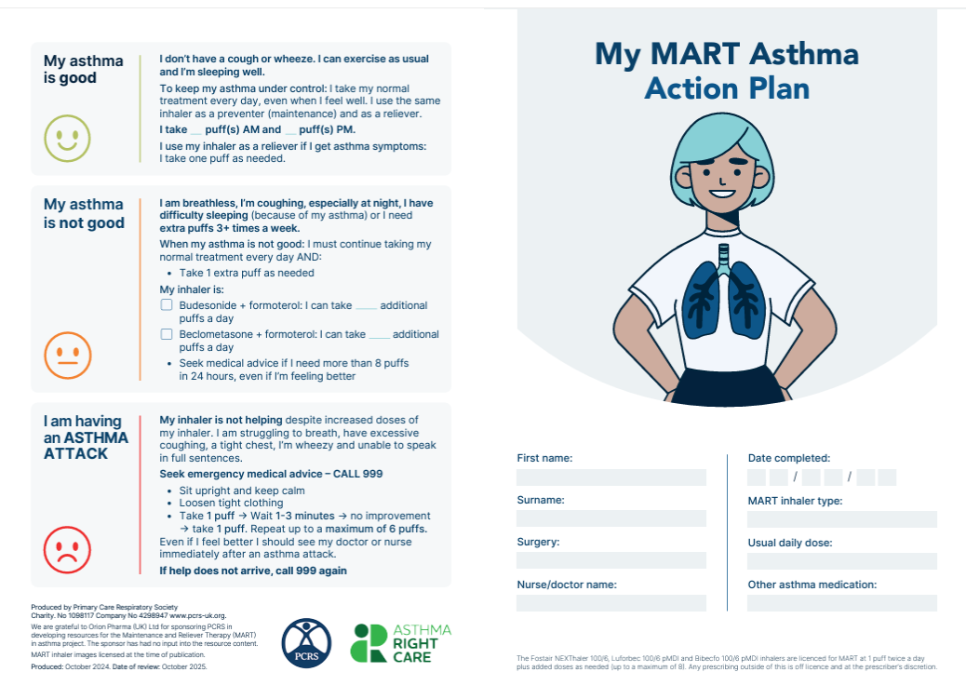
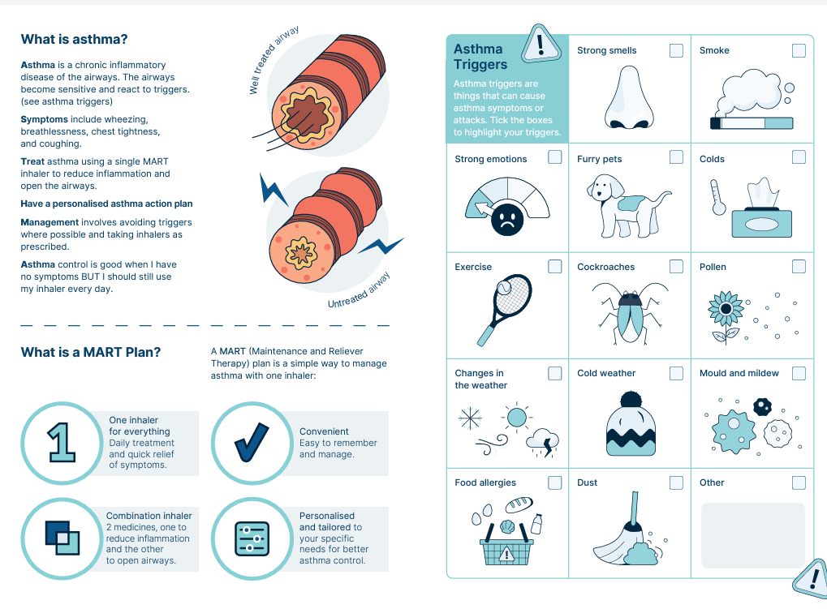
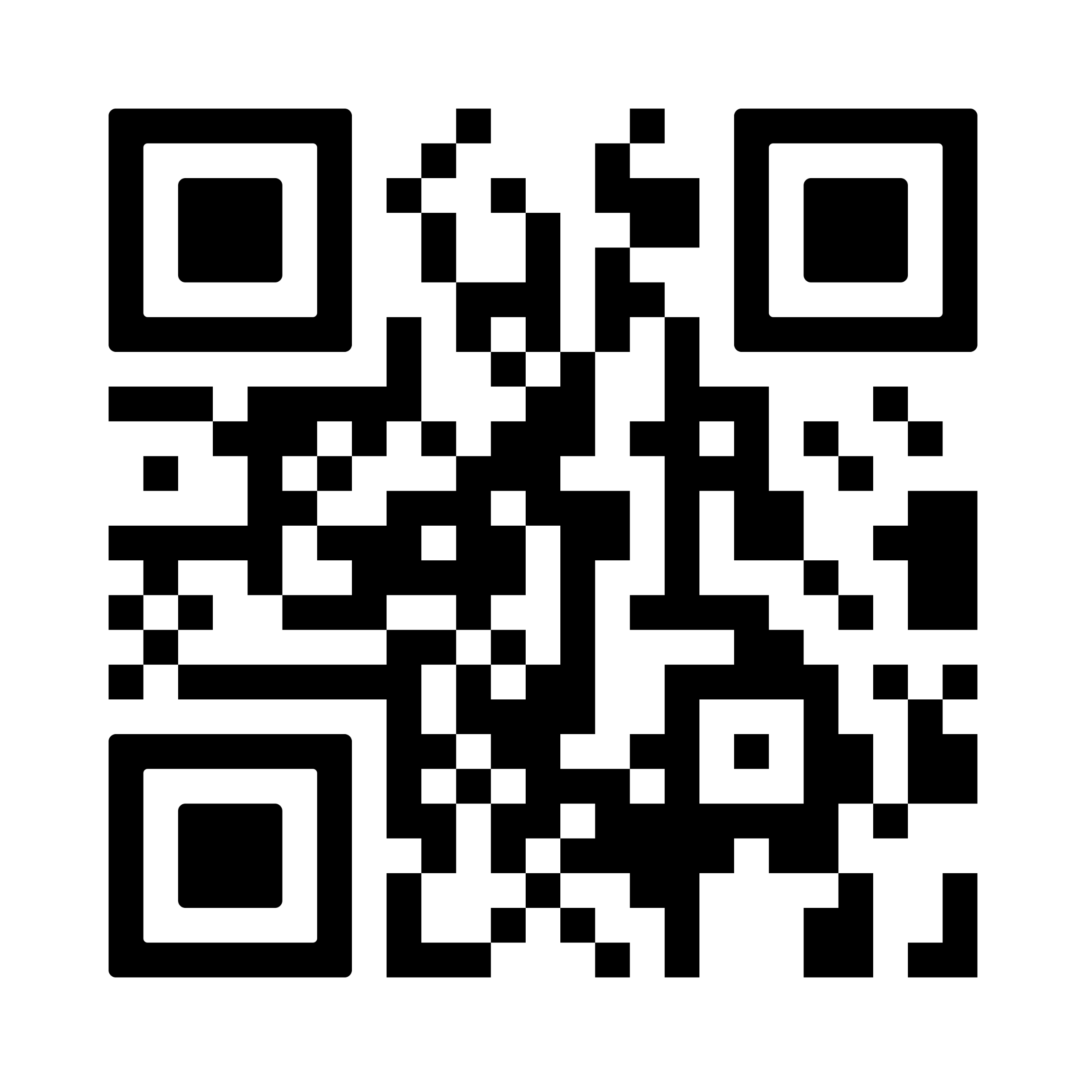
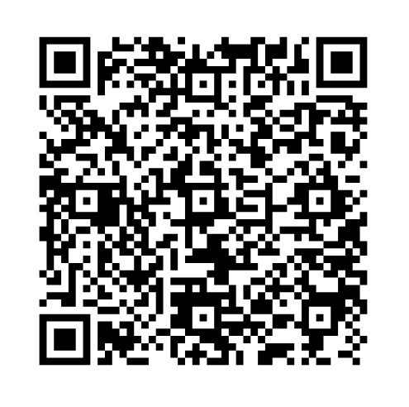
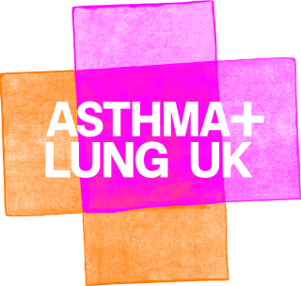
Self-management
AIR and MART action plans are available via the PCRS and Asthma and Lung UK websites.
AIR and MART plans
Asthma action plans
Medication and how to take it effectively
Triggers
Maximum number of doses
When to seek help
Tobacco dependency
PCRS MART action plan
A+LUK AIR action plan
For more information on AIR/MART treatment see the Treatment section of this Slide Kit
Notes:
References = 3. Clinical Knowledge Summaries: Asthma: https://cks.nice.org.uk/topics/asthma/ and 4. Cochrane Review: Personalised asthma action plans for adults with asthma: www.cochranelibrary.com/cdsr/doi/10.1002/14651858.CD011859.pub2/full?)

Slide 48

Monitoring progress

Slide 49
Monitoring asthma control
Monitoring progress for individuals with asthma is about ensuring effective asthma control and quality of life. This can be done by:
Conducting regular inhaler technique checks
Individuals with asthma must know how to use their inhalers properly. This will ensure optimum delivery of medication to the lungs.
This should be done at annual reviews and for ALL new prescriptions of asthma inhalers.
Up to 80% of asthma patient use their inhalers incorrectly.
Ensuring annual reviews are done by appropriately trained healthcare profession
PCRS Fit to Care resource can support healthcare professionals with their skills and knowledge of respiratory care.
Assessing asthma control and treatment options at all appropriate opportunities
This will support effective step up and step down of treatment and treatment options discussions with the patient.

Slide 50

Implementing the asthma guideline:
Are we doing it right?
Have we made an early and accurate diagnosis?
  Availability of tests locally across our system to support timely diagnosis
  Percentage of patients where the diagnosis is made to national standards
Are we supporting good, cost-effective prescribing practices?
  Several national parameters of the quality of prescribing are available
Have there been fewer hospital admissions and unscheduled GP visits?
  How do we compare to others with similar populations and around our region?
Have there been no avoidable asthma deaths in our area?
  If we do have a death this will be investigated to ensure learning
Have we worked with practices to conduct appropriate audits to identify patients requiring treatment change?
Have we reduced SABA only pathways in our area?
Are children and young people receiving the right asthma care?
Use these areas to set SMART objectives for your practices
Notes:
Speaker notes:
SABA = Short-acting beta-agonists
Early and accurate diagnosis
- Availability of diagnostic tests locally across our system to support timely diagnosis (FeNO and spirometry)
- Percentage of patients where the diagnosis is made to national standards
Reduction in prescribing costs
- Several national parameters of quality of prescribing available
Fewer hospital emergency admission and unscheduled GP visits
- How we compare to others with similar populations and around our region
Avoidable asthma deaths
- If we do have a death this will be investigated to ensure learning
Treatment audits
Patients on SABA only pathways or with high numbers of SABA prescriptions
Patients whose asthma is well controlled and who could potentially move to a combined inhaler system (AIR/MART)
Patients who have been admitted to hospital with asthma attack or who have requested an unscheduled GP visit due to their asthma
Patients who are not attending their annual asthma reviews
SABA only pathways
- Use of SABA alone is associated with higher risk of uncontrolled asthma, frequent asthma attack, more hospital admission and adverse outcomes.
National datasets which can be used to measure these metrics
EMIS and System One to run internal audits
Quality Outcomes Framework (QOF) data
Fingertips
NHS England, respiratory dashboards
- Office for National Statistics (ONS)
National Respiratory Audit Programme (NRAP)
Data.gov.uk
Data – Digital Health and Care Wales (DHCW)
See Asthma and Lung Uks Digital Asthma report for more information on action which can be taken at commissioner, Primary Care Network and Health professional level: digital_asthma_report.pdf

Slide 51





Successful implementation is imperative for guideline success !!!!!
The new BTS/SIGN/NICE 2024 guideline offers a comprehensive, evidence-based framework that aligns with ICB/health board/Trust objectives for standardised, equitable, and cost-effective asthma care.
Implementing these guidelines effectively will lead to improved patient outcomes, reduced emergency admissions, and a stronger focus on proactive asthma management.
Education
Teamwork
Collaborative approach
Incentives and investment
PCN Respiratory Champions
Notes:
Speaker notes:
Key Messages for Successful implementation
Early diagnosis and treatment improve long-term outcomes
Avoid over-reliance on SABA: Regular use indicates poor control
Strong communication between healthcare and education sectors
Reference = 2. BTS/NICE/SIGN asthma guideline 2024

Slide 52




Take action now!
Adopt and implement: Ensure that local care pathways reflect these updated guidelines.
Educate and train: Provide training for healthcare teams to ensure alignment with best practices.
Monitor and evaluate: Use data-driven approaches to track asthma outcomes and reduce inequalities.
Engage communities: Work with schools, workplaces, and local organisations to support asthma-friendly environments.
Implement
Educate and train
Monitor and Evaluate
Engage communities
Notes:
Key Messages for Successful implementation
Early diagnosis and treatment improve long-term outcomes
Avoid over-reliance on SABA: Regular use indicates poor control
Strong communication between healthcare and education sectors

Slide 53






Slide 54

Resources and references
Notes:
Resources and references

Slide 55
PCRS resources
Campaigns and information hubs
Asthma Right Care - https://qrco.de/bdP8sO
Greener Healthcare - https://qrco.de/bdamwr
Fit to Care - https://qrco.de/bdzFjI
Health inequalities - https://qrco.de/beI9b3
Supporting people with asthma in the 21st century resources - https://qrco.de/bfLbH5 (podcast x2, animation x2, webinar x1)
Resource repositories
Asthma - www.pcrs-uk.org/asthma
Inhaler devices - www.pcrs-uk.org/resource/current/inhaler-devices
Diagnostic testing (includes FeNO, POC and Spirometry) - www.pcrs-uk.org/diagnostic-testing
Tobacco Dependency - www.pcrs-uk.org/tobacco-dependency
Diagnosis
Podcast – Diagnosing asthma (MEMBERS ONLY RESOURCE) - www.pcrs-uk.org/resource/current/podcast-diagnosis-asthma
Spirometry and Peak Flow resources - www.pcrs-uk.org/spirometry
FeNO resources - www.pcrs-uk.org/feno
Features and diagnosis of asthma - www.pcrs-uk.org/resource/current/features-and-diagnosis-asthma

Slide 56
PCRS resources
Treatment
Tailoring Inhaler Choice - https://qrco.de/bfT76Y
‘Blanket’ switching of inhaler types: Why is this a bad idea? - www.pcrs-uk.org/resource/current/blanket-switching-inhaler-types-why-bad-idea
MART top tips - https://qrco.de/bfRfRL
Podcast: Tackling SABA overuse – https://qrco.de/bfbSKE
MART webinar - www.pcrs-uk.org/resource/current/demand-webinar-introduction-maintenance-and-reliever-therapy-mart
Asthma in schools – Be proactive, not reactive - www.pcrs-uk.org/resource/current/demand-webinar-asthma-schools-be-proactive-not-reactive
Monitoring and self-management
Building blocks to a good asthma review - https://qrco.de/bfbSUv
Podcast: A good asthma review (MEMBERS ONLY RESOURCE)- https://qrco.de/bfbSSS
MART action plan - https://qrco.de/bfRfQA
Podcast: Asthma action plans - www.pcrs-uk.org/resource/current/podcast-asthma-action-plans
Greener healthcare and health inequalities
In conversation: Heath inequalities - www.pcrs-uk.org/resource/current/pcrs-conversation-health-inequalities
In conversation: Health inequalities: Health literacy and Understanding - www.pcrs-uk.org/resource/current/pcrs-conversation-health-inequalities-health-literacy-and-understanding
Greener Respiratory Pathway (Supported self-management and action plans) - www.pcrs-uk.org/greener-respiratory-pathway/resource/supported-self-management-and-action-plans

Slide 57

Asthma and Lung UK
Respiratory Champions
The Asthma and Lung UK Respiratory Champions pilot project has funded six ‘Respiratory Champions’ within six local NHS areas (England).
Champions are local respiratory specialist healthcare professions who are passionate about improving respiratory care and outcomes at local and national levels.
For more information about these and to locate your Respiratory Champion go to: www.asthmaandlung.org.uk/healthcare-professionals/resp-champions.

Slide 58
Asthma and Lung UK resources
Healthcare professionals hub: www.asthmaandlung.org.uk/healthcare-professionals
Training and development: www.asthmaandlung.org.uk/healthcare-professionals/training-development
Symptoms, tests and treatments: www.asthmaandlung.org.uk/symptoms-tests-treatments
Information for people living with lung conditions: www.asthmaandlung.org.uk/living-with
How to use your inhaler: www.asthmaandlung.org.uk/living-with/inhaler-videos

Slide 59

Other resources
Asthma Right Care (IPCRG): www.ipcrg.org/asthmarightcare
Global Initiative for Asthma – GINA: https://ginasthma.org/
RightBreathe: www.rightbreathe.com

Slide 60

References
The following sources of information have been used to inform this toolkit.
  Asthma and Lung UK www.asthmaandlung.org.uk/
  BTS/NICE/SIGN asthma guideline: www.brit-thoracic.org.uk/quality-improvement/guidelines/asthma/
  Clinical Knowledge Summaries: Asthma: https://cks.nice.org.uk/topics/asthma/
  Cochrane Review: Personalised asthma action plans for adults with asthma: www.cochranelibrary.com/cdsr/doi/10.1002/14651858.CD011859.pub2/full?)
  GINA 2022 report: https://ginasthma.org/gina-reports/
  GINA 2024 report: https://ginasthma.org/2024-report/
  National Institute for Health and Care Excellence: www.nice.org.uk/
  8. NHS England www.england.nhs.uk/
  Royal College of Paediatrics and Child Health. State of Child Health. 2020. https://stateofchildhealth.rcpch.ac.uk/
  Royal College of Physicians. National Review of Asthma Deaths: Why Asthma Still Kills. 2014. www.rcp.ac.uk/improving-care/resources/why-asthma-still-kills/
NOTE: Some specific research paper references are included on the slide they pertain to

Slide 61









Acknowledgements
Reviewers and content consultation
Production team
  Frances Barrett
  Steve Holmes
Darush Attar-Zadeh
  Helena Cummings
  Nazir Hussain
Tricia Bryant
The Primary Care Respiratory Society is grateful to its corporate supporters including AstraZeneca UK Ltd, Chiesi Ltd, GlaxoSmithKline (GSK) plc and Lupin Healthcare Limited, for their financial support which supports the core activities of the Charity and allows PCRS to make its services either freely available or at greatly reduced rates to its members. Corporate sponsors have no input into the content of PCRS resources.
  Katherine Hickman
  Michelle O’Driscoll
Deborah Leese

