Slide 1

Asthma Guideline 2024
REMOVE BEFORE PRESENTATION:
Check the notes sections for additional information and speaker notes
<Add your own title here>
Implementing the 2024 BTS/NICE/SIGN asthma guideline
This work is licenced under CC BY-NC 4.0

Slide 2

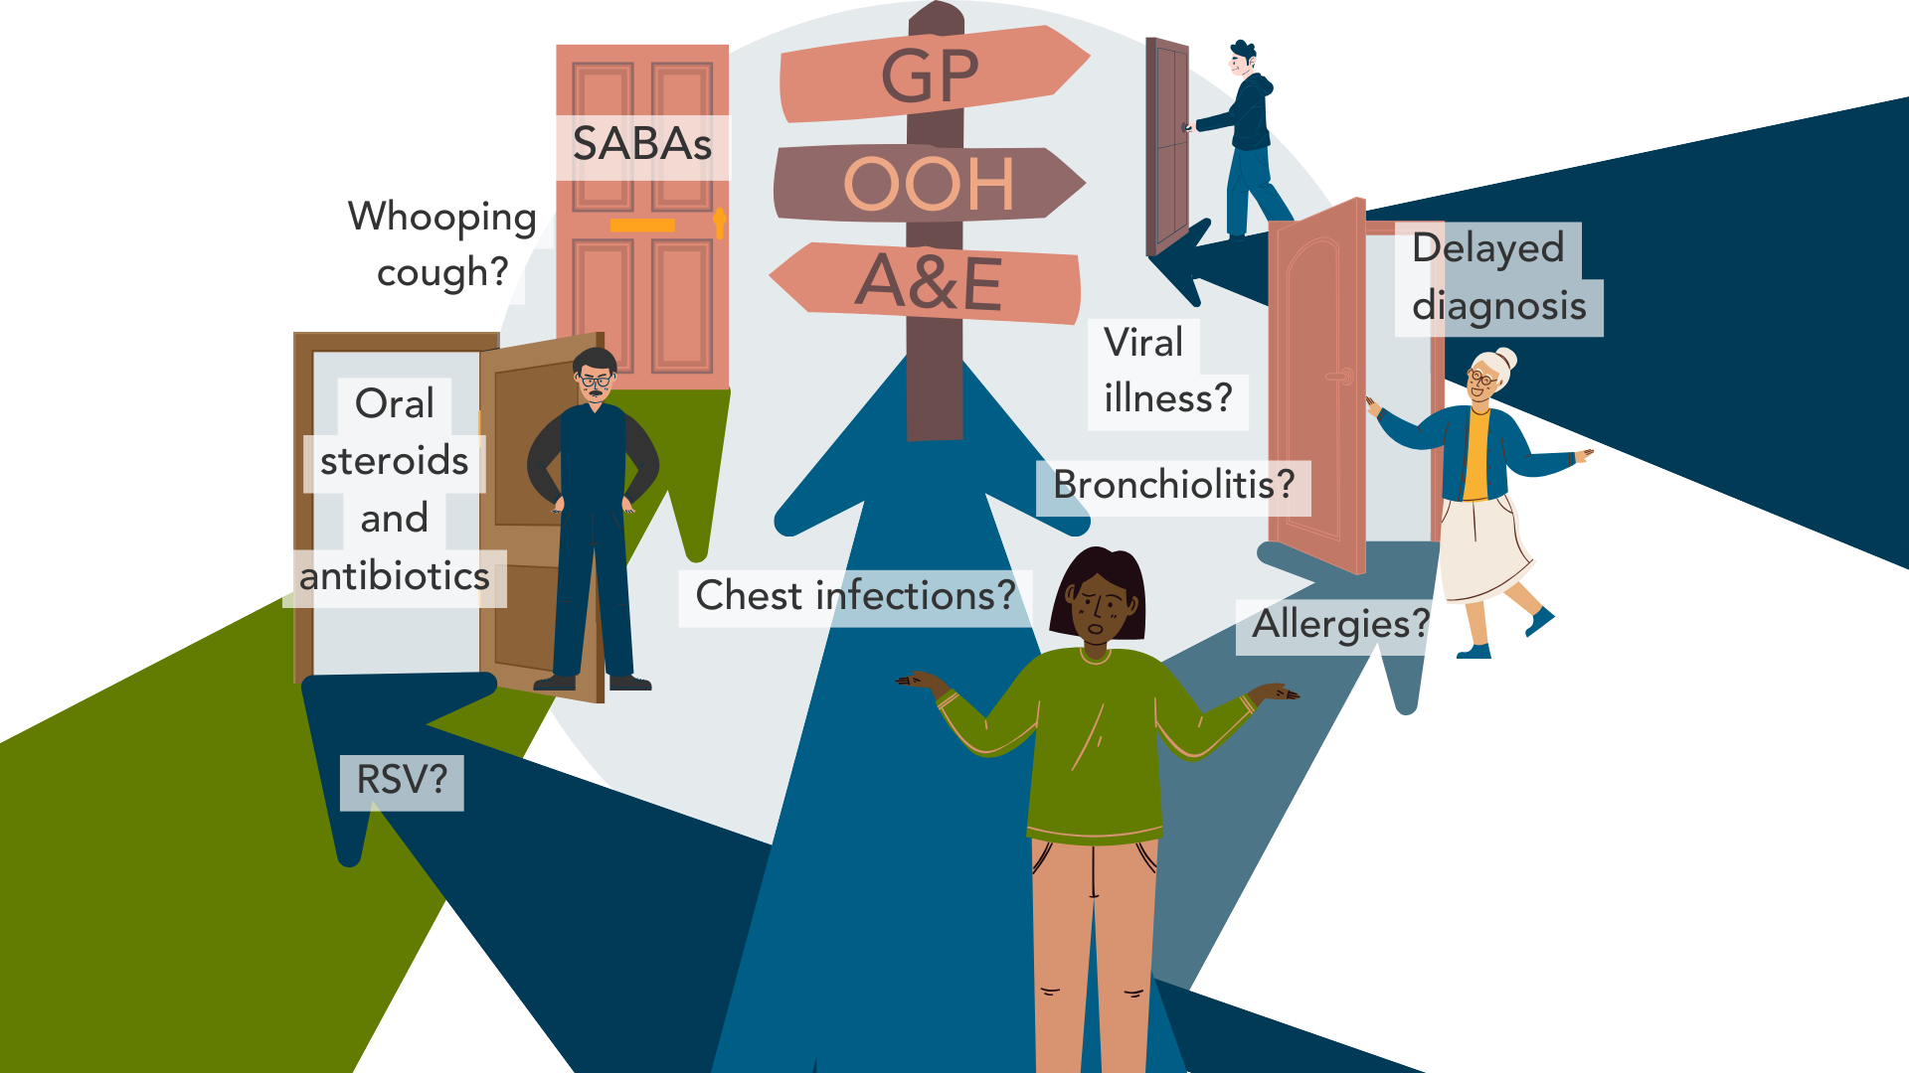




Why do we need to do something about asthma?
Reduce avoidable asthma deaths
Reduce overarching healthcare costs
Reduce avoidable hospital admissions
Reduce unscheduled GP visits
Supporting early & accurate diagnosis
Reduce inappropriate prescribing and associated risks and costs
Notes:
Speaker notes:
Asthma prevalence
- The number of people affected by asthma in the UK is amongst the highest worldwide.
- Up to 5.4 million people in the UK are receiving treatment for asthma. Asthma accounts for high numbers of consultations in primary care, out-of-hours services, and hospital emergency departments [RCP, 2014].
- Asthma is the most common long-term medical condition in children and young people in the UK with around 1:11 children and young people living with asthma (NHS England)
- The UK has one of the highest prevalence, emergency admission and death rates for childhood asthma in Europe. Outcomes are worse for children and young people living in the most deprived areas (Royal College of Paediatrics and Child Health (2020) State of Child Health).
Asthma facts
- NICE report that a third of adults diagnosed with asthma have no actual clinical signs of asthma (NICE)
- Asthma can be under-diagnosed as well - with eight out of ten asthma sufferers still not getting the correct basic care (Asthma + Lung UK)
- Overdiagnosis of asthma is thought to be common in children leading to unnecessary treatment, disease burden, and impact on their quality of life
- Ten Years on from the National review into asthma deaths (NRAD) published in 2014 – the annual asthma death toll has risen by 25%

Slide 3



Respiratory Care Action Plan
Key priorities
Getting the diagnosis right
Getting the asthma treatment right
Getting the asthma training right
Notes:
Speaker notes:
Getting the diagnosis right
Investing in testing tools such as FeNO and spirometry
Getting the asthma treatment right
Supporting local incentives to review the treatment of people with asthma in accordance with the new guideline
Raising awareness of the risks associated with short-acting beta-agonist (SABA) free pathways
Getting the asthma training right
- Adopting PCRS Fit to Care across entire workforce to ensure all have appropriate knowledge, skills and training of healthcare professionals treating individuals with asthma
- Provide educational updates to the workforce on the new guidelines via PCRS slide kits and online learning modules
See slide 6 for further information.

Slide 4

The UK asthma crisis: We must act now
Without action, individuals remain at risk of:
worsening asthma control,
more frequent asthma attacks,
emergency hospital admissions,
unscheduled GP visits,
avoidable asthma deaths, and
increased NHS costs.
You can make meaningful CHANGE happen
Notes:
See the toolkit asthma death case studies for more information on the impact of no action being taken.
Asthma UK: There are more than 10 million asthma attacks each year. Available at: https://shorturl.at/qA4Z1 [Accessed Dec 2024]
The Pharmaceutical Journal. Asthma-related death rate in UK among highest in Europe, charity analysis finds. Available at: https://shorturl.at/rhGk5 [Accessed Dec 2024)

Slide 5

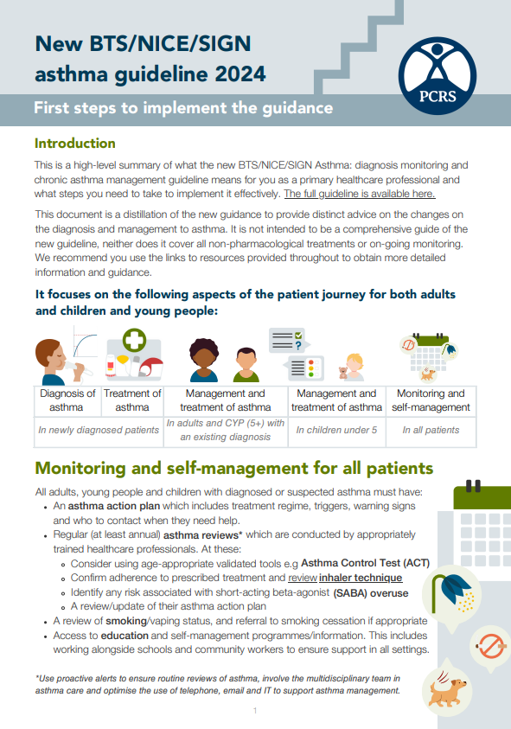

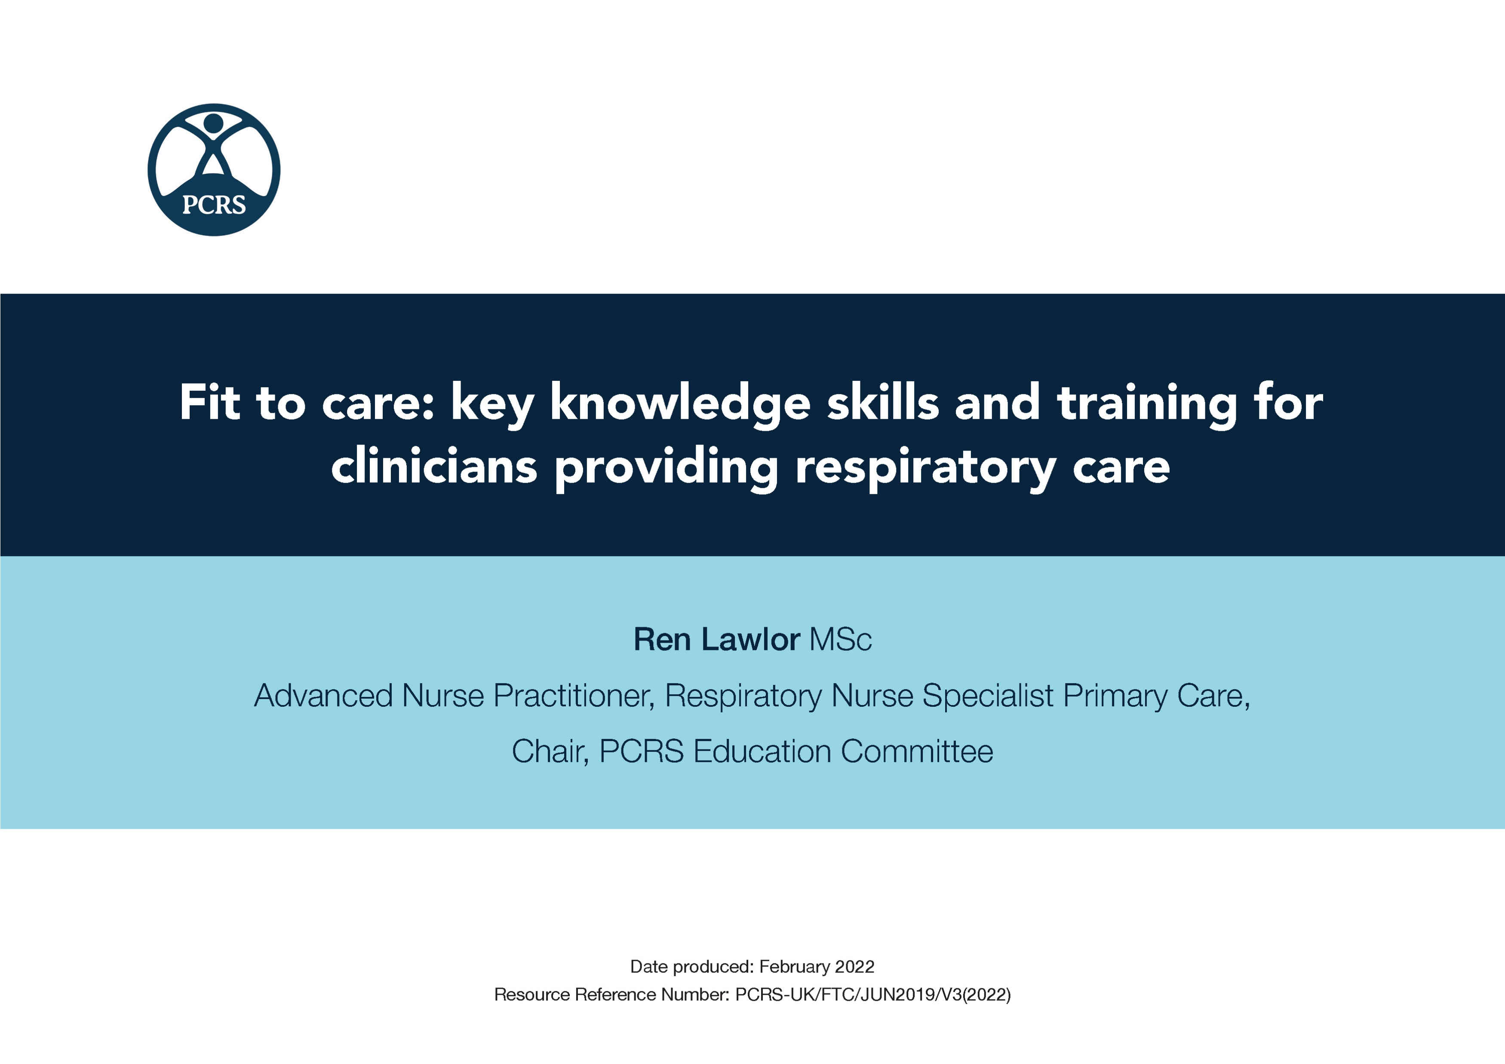

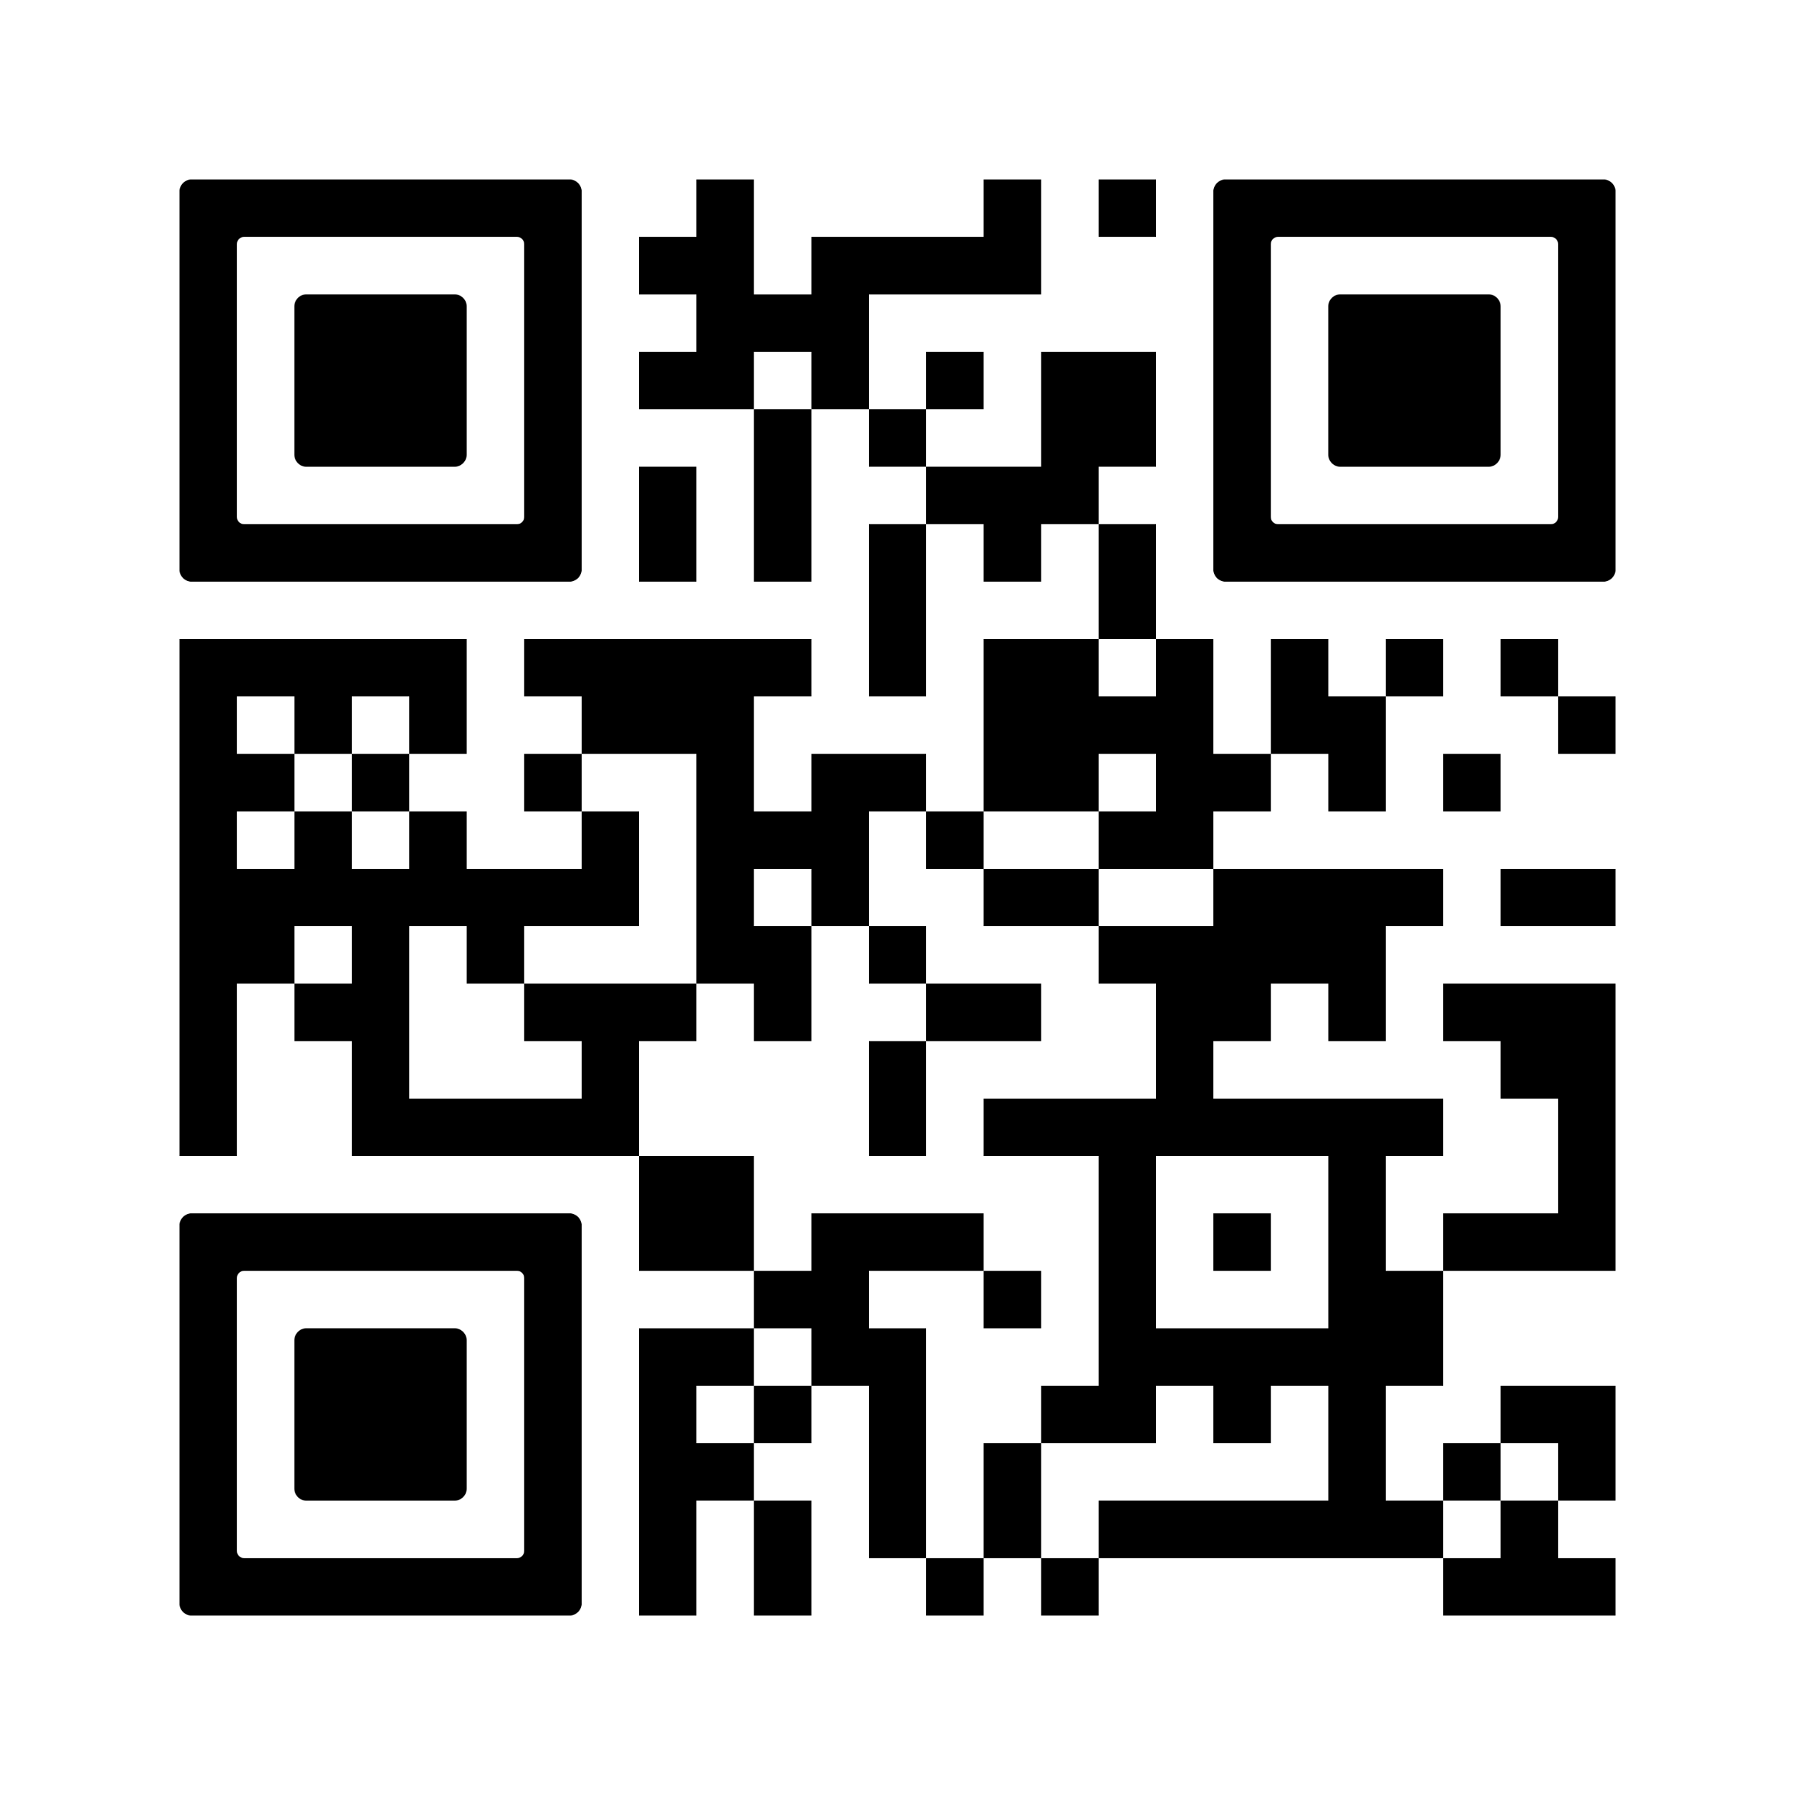

Take action now!
Update local guidance based on the evidence of the new NICE BTS SIGN Asthma Pathway
Support practices, using data, to risk stratify patients requiring review and treatment change
Educate the workforce on the changes to the national guidance and its implications on practice
Provide support and investment for diagnostic testing, including training (FeNO and spirometry specifically)
Launch patient education campaigns to improve awareness of asthma risks
By making these changes, we can enhance patient safety, reduce hospital and unscheduled GP visits and reduce prescribing costs.
You can take the necessary steps to transform asthma care!
PCRS resources and events which can support you do this:
Fit to Care | PCRS Conference | Online learning modules (available to PCRS members only) | First steps to implementing the new asthma guideline
Notes:
Speaker notes:
FeNO = Fractional exhaled nitric oxide
How long will PCRS learning modules take to complete?
- Approximately 1 hour.

Slide 6
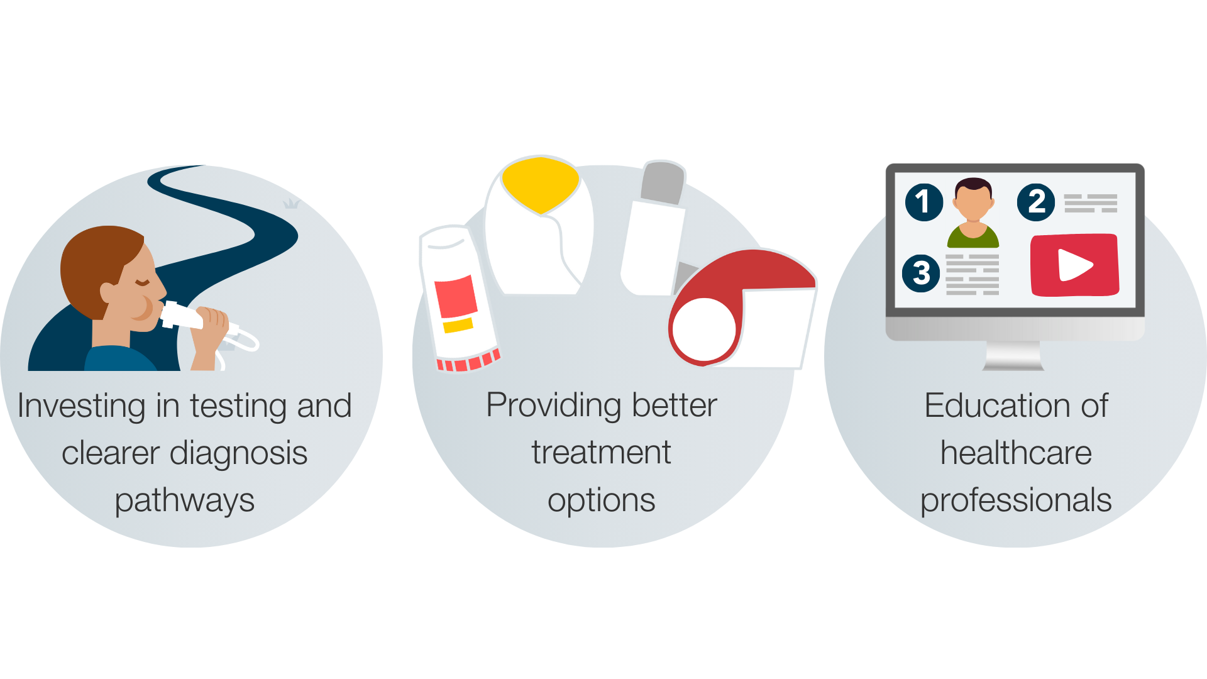
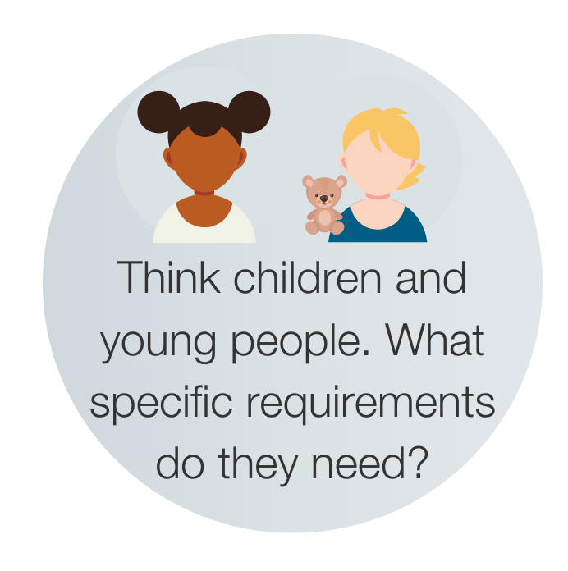

How can you do this?
Implementing the new guideline
Provide support to practices to invest in respiratory diagnostic testing (specifically FeNO and spirometry)
Support local incentives to review the treatment of people with asthma in accordance with the new guideline
Adopting Fit to Care across entire workforce to ensure all have appropriate knowledge, skills and training
Provide educational updates to the workforce on the new guidelines via PCRS slide kits and online learning modules
Support key workforce colleagues to become members of PCRS for regular respiratory updates and access to training/conferences
Notes:
Speaker notes:
FeNO = Fractional exhaled nitric oxide

Slide 7

How will we monitor progress?
Are we doing it right?
Have we made an early and accurate diagnosis?
Are we supporting good, cost-effective prescribing practices?
Are there fewer hospital admissions and unscheduled GP visits?
Have there been no avoidable asthma deaths in our area?
Have we worked with practices to conduct appropriate audits to identify patients requiring treatment change?
Have we reduced SABA only pathways in our area?
Are children and young people receiving the right asthma care?
Use these areas to set SMART objectives for your practices.
Notes:
Speaker notes:
SABA = Short-acting beta-agonists
Early and accurate diagnosis
- Availability of diagnostic tests locally across our system to support timely diagnosis (FeNO and spirometry)
- Percentage of patients where the diagnosis is made to national standards
Reduction in prescribing costs
- Several national parameters of quality of prescribing available
Fewer hospital emergency admission and unscheduled GP visits
- How we compare to others with similar populations and around our region
Avoidable asthma deaths
- If we do have a death this will be investigated to ensure learning
Treatment audits
Patients on SABA only pathways or with high numbers of SABA prescriptions
Patients whose asthma is well controlled and who could potentially move to a combined inhaler system (AIR/MART)
Patients who have been admitted to hospital with asthma attack or who have requested an unscheduled GP visit due to their asthma
Patients who are not attending their annual asthma reviews
SABA only pathways
- Use of SABA alone is associated with higher risk of uncontrolled asthma, frequent asthma attack, more hospital admission and adverse outcomes.
National datasets which can be used to measure these metrics
EMIS and System One to run internal audits
Quality Outcomes Framework (QOF) data
Fingertips
NHS England, respiratory dashboards
- Office for National Statistics (ONS)
National Respiratory Audit Programme (NRAP)
Data.gov.uk
Data – Digital Health and Care Wales (DHCW)
See Asthma and Lung Uks Digital Asthma report for more information on action which can be taken at commissioner, Primary Care Network and Health professional level: digital_asthma_report.pdf

Slide 8
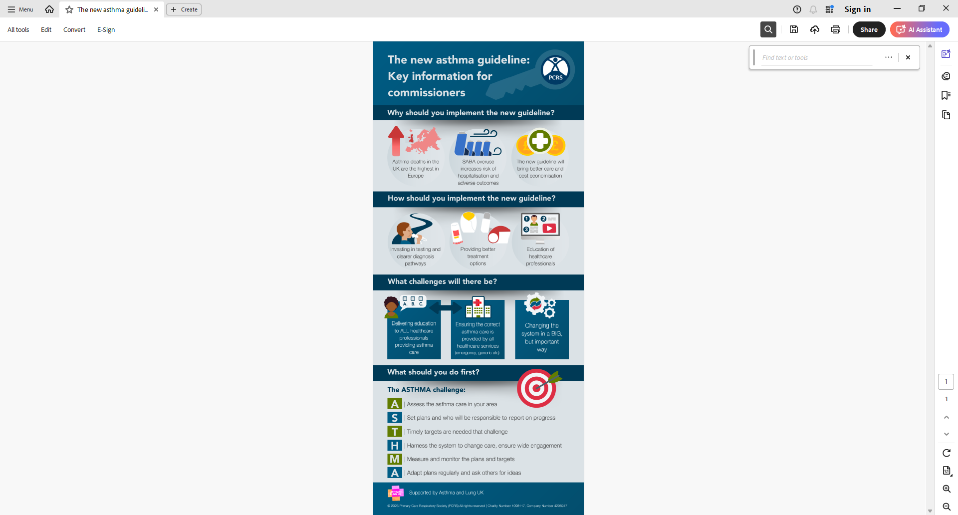

Key information for commissioners
PCRS has produced a full toolkit to support commissioners with implementing the new asthma guideline.

Slide 9

References
The following sources of information have been used to inform this toolkit.
  Asthma and Lung UK www.asthmaandlung.org.uk/
  BTS/NICE/SIGN asthma guideline: www.brit-thoracic.org.uk/quality-improvement/guidelines/asthma/
  Clinical Knowledge Summaries: Asthma: https://cks.nice.org.uk/topics/asthma/
  Cochrane Review: Personalised asthma action plans for adults with asthma: www.cochranelibrary.com/cdsr/doi/10.1002/14651858.CD011859.pub2/full?)
  GINA 2022 report: https://ginasthma.org/gina-reports/
  GINA 2024 report: https://ginasthma.org/2024-report/
  National Institute for Health and Care Excellence: www.nice.org.uk/
  NHS England www.england.nhs.uk/
  Royal College of Paediatrics and Child Health. State of Child Health. 2020. https://stateofchildhealth.rcpch.ac.uk/
  Royal College of Physicians. National Review of Asthma Deaths: Why Asthma Still Kills. 2014. www.rcp.ac.uk/improving-care/resources/why-asthma-still-kills/
Notes:
Research specific references can be found in the full Education Pack.

Slide 10
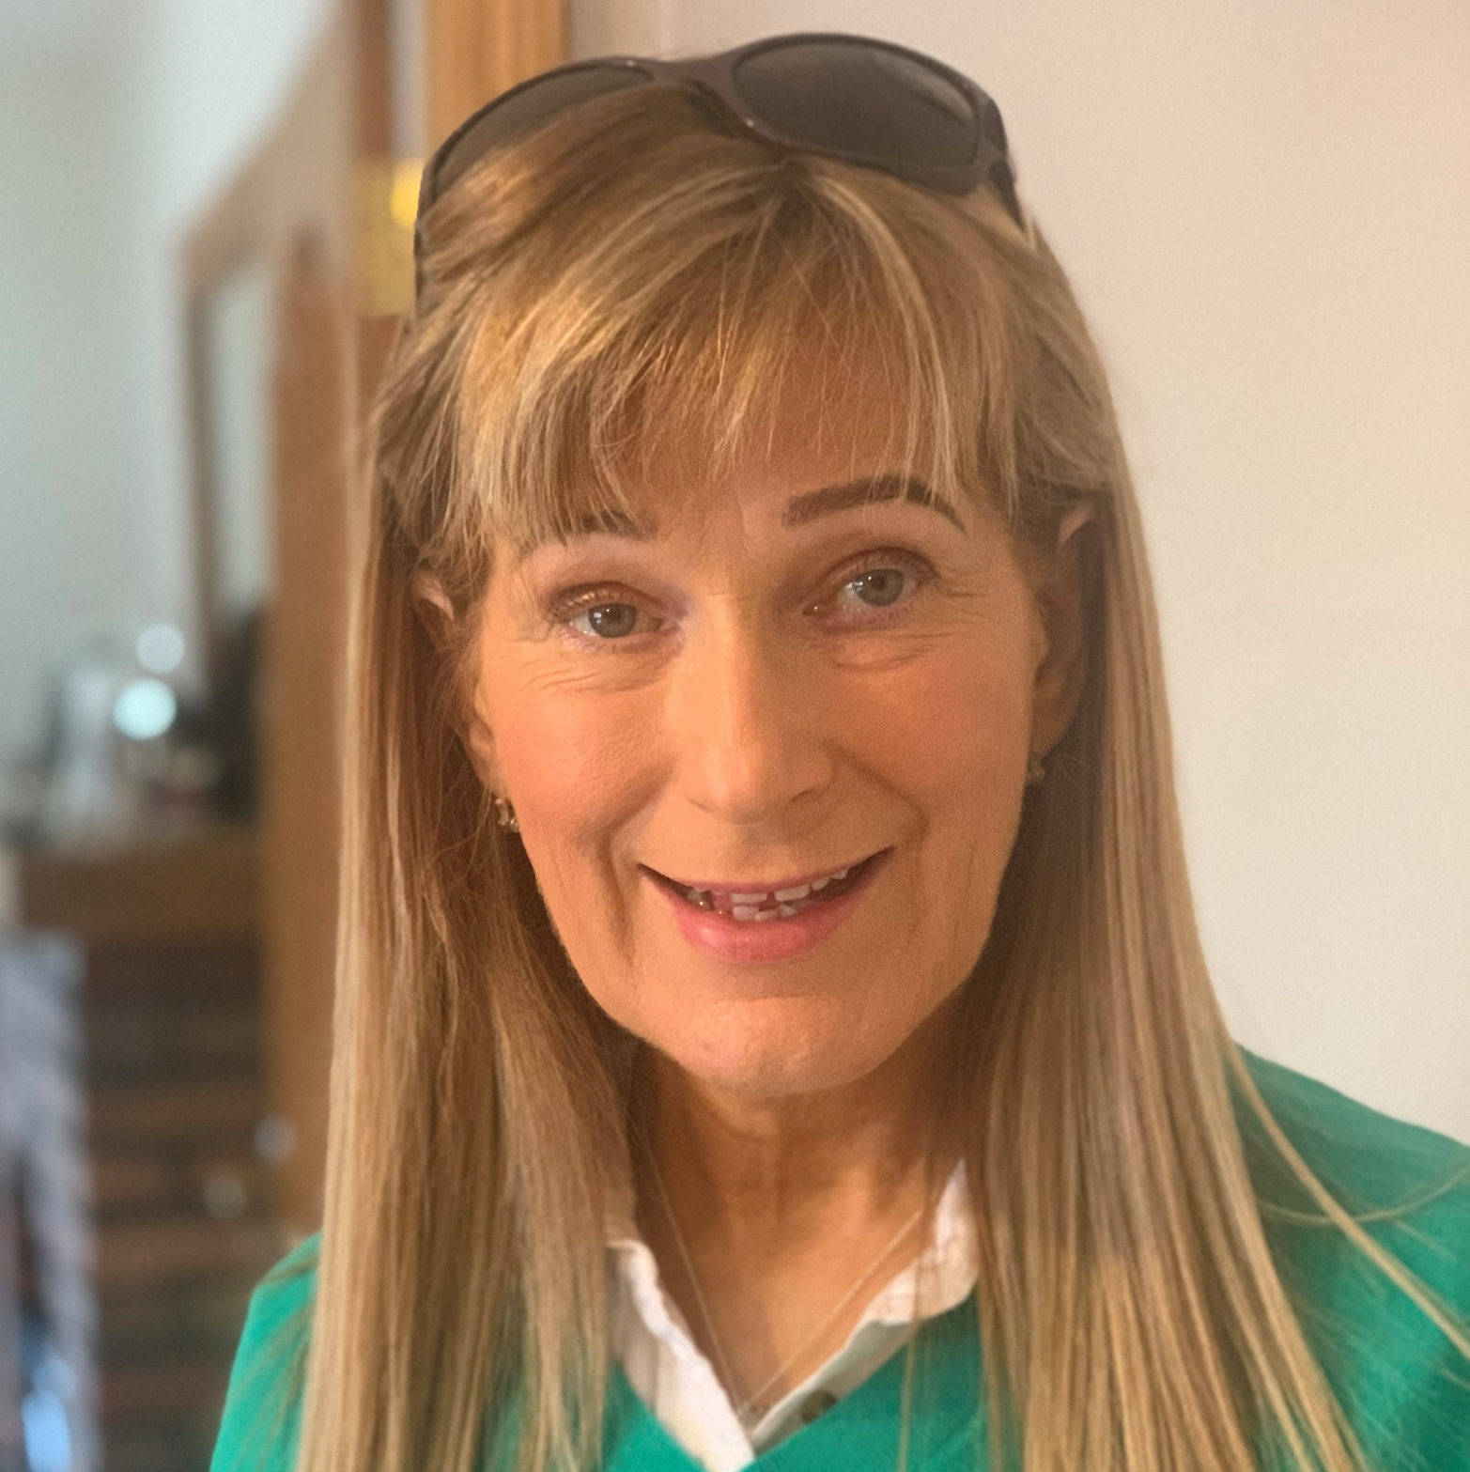








Acknowledgements
Reviewers and content consultation
Production team
  Frances Barrett
  Steve Holmes
Darush Attar-Zadeh
  Helena Cummings
  Nazir Hussain
Tricia Bryant
The Primary Care Respiratory Society is grateful to its corporate supporters including AstraZeneca UK Ltd, Chiesi Ltd, GlaxoSmithKline (GSK) plc and Lupin Healthcare Limited, for their financial support which supports the core activities of the Charity and allows PCRS to make its services either freely available or at greatly reduced rates to its members. Corporate sponsors have no input into the content of PCRS resources.
  Katherine Hickman
  Michelle O’Driscoll
Deborah Leese

