Slide 1
Project Planning – Consider running as a Quality Improvement project?
“QI is a commitment to continuously improving the quality of healthcare, focusing on the preferences and needs of the people who use services.”
(Royal College of General Practitioners 2017)
Giving the people closest to issues the time, permission, skills and resources they need to solve them.
It involves a systematic and coordinated approach to solving a problem using specific methods and tools with the aim of bringing about a measurable improvement.

Slide 2
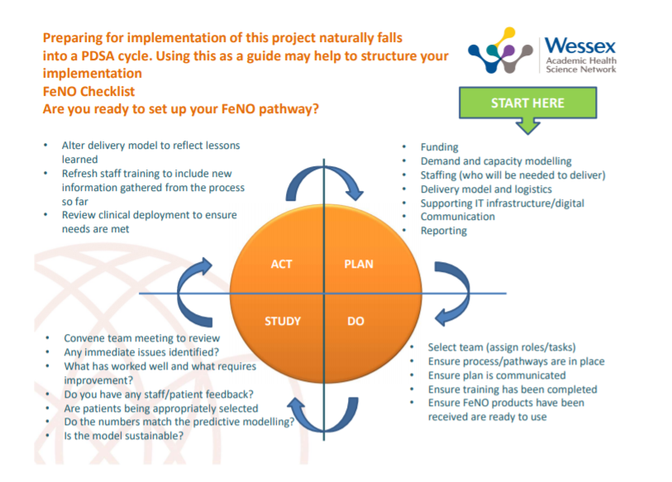
Plan Do Study Act (PDSA)
Straight forward structure
Allows for prompt implementation and rapid evaluation.
We have included a guide on the FeNO web pages if you would like further detail

Slide 3
Plan Do Study Act (PDSA)

Slide 4

Initial Engagement - When setting up your FeNO project, identify your team – their participation is vital for success
Your key stakeholders/project members will include colleagues from a range of disciplines. You will need to decide upon the following;
Project Lead
Clinical Lead (may be same as project lead e.g. Lead respiratory GP or Nurse
Finance/Procurement (e.g. Practice Manager)
Training/Competency sign-off (may be same as clinical lead)
Measurement/analytics
Admin
It may just be you, in which case ensure you communicate with wider involved parties
ACT
PLAN
PLAN
STUDY
DO

Slide 5
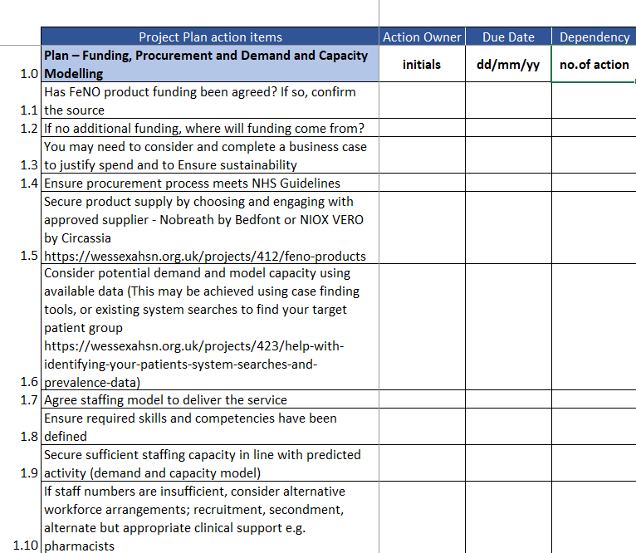
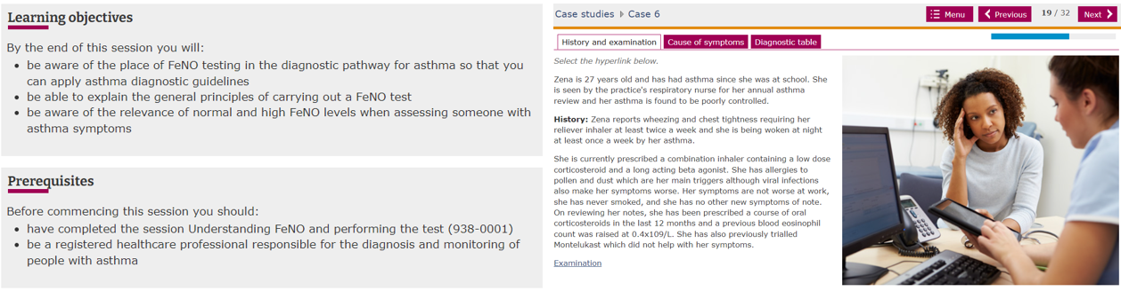
Project Planning - Develop a plan for implementation
Utilise project planning template to ensure all necessary elements have been discussed and considered as part of plan.
Explore the template FeNO project plan
Include milestones as date markers for your project development
Remember to capture and document any risks/issues (both clinical and operational) and consider mitigation plan
Funding
Product supply
Patient group
Staffing
Training
ACT
PLAN
PLAN
STUDY
DO

Slide 6
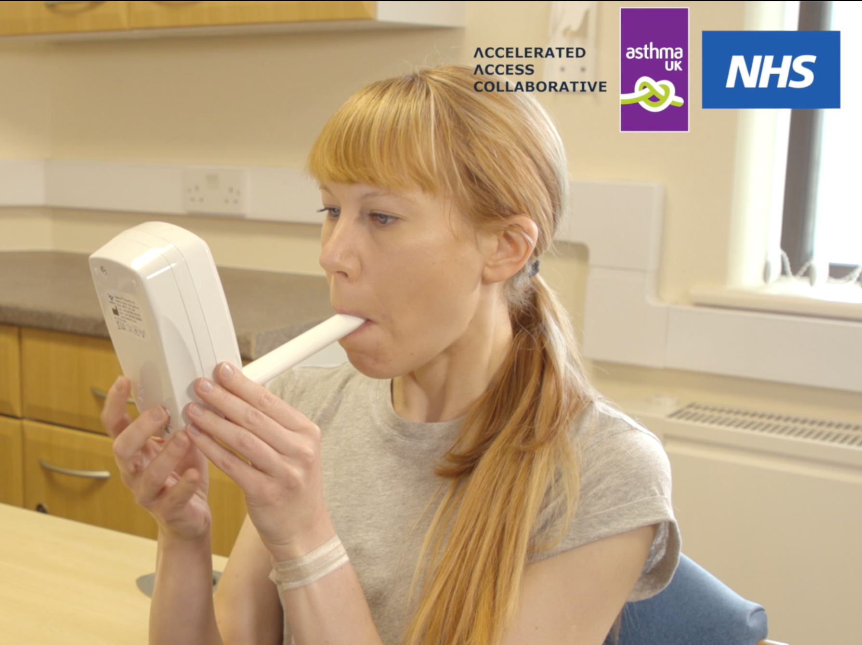
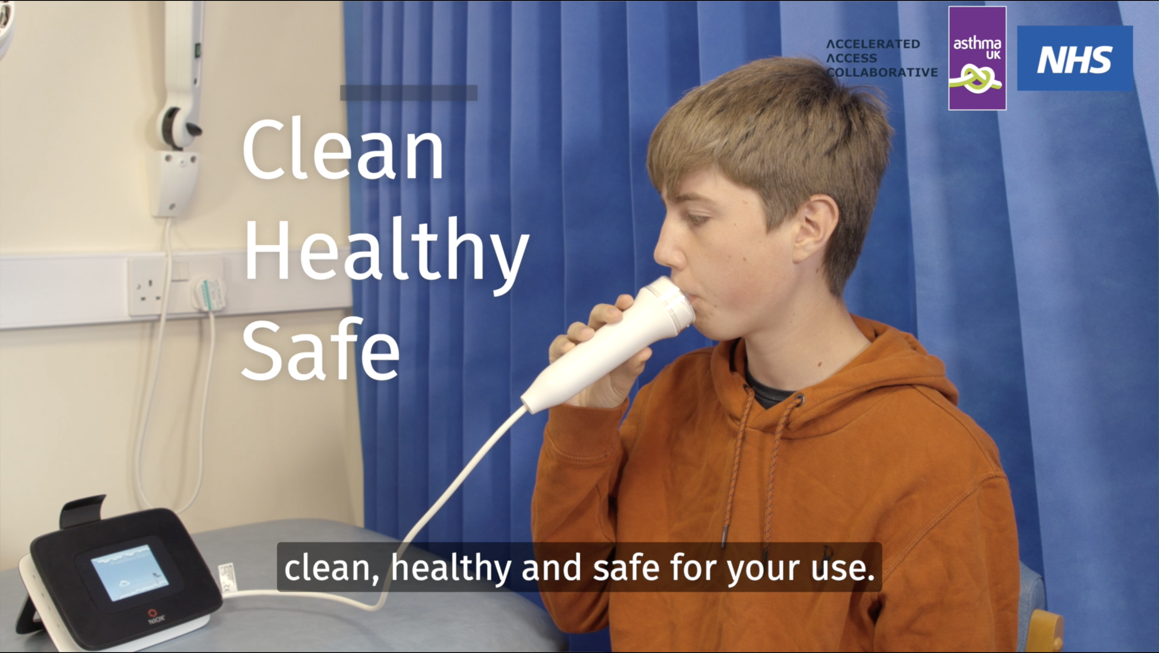
Deploy - Start small and scale up
Use agreed searches to choose your patient group – start small
Use agreed comms to contact patients (accuRx FeNO info is available)
Ensure staff training is complete and competencies signed-off
Ensure venue is appropriate and follows IPC guidelines
Can patient record be updated with result and appropriate SNOMED code?
Is everyone ready? If so go live
ACT
PLAN
DO
STUDY
DO

Slide 7
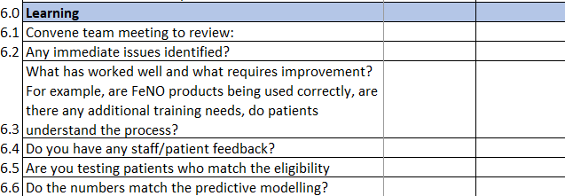
Project review - any changes needed?
Meet with team, or set aside time for yourself to review
Have your project milestones been met? (check for any delays/barriers/challenges)
Review early data, if available
What has gone well?
What could be improved?
Any feedback to action?
ACT
PLAN
STUDY
STUDY
DO

Slide 8

Is FeNO testing ready to become Business as Usual?
Is everything in place for this new pathway and test to become your new/usual pathway?
If not, what do we need to do? Re-visit checklist/milestones
What have we learnt? What is the learning we’d share?
What does the data tell us? Is it what we expected?
Can we share/promote out work? With who?
Who is going to write up our project evaluation? (suggested evaluation template here)
ACT
ACT
PLAN
STUDY
DO

