Slide 1
Promoting and presenting persuasively
Melissa Canavan
Stephen Gaduzo

Slide 2
“First tell ‘em you’re gonna tell ‘em, then tell ‘em, then tell ‘em you’ve told ‘em”
“The single biggest problem with communication is the illusion that it has taken place”
George Bernard Shaw

Slide 3
NICE Quality Standards QS25 //
Statement 1. People with newly diagnosed asthma are diagnosed in accordance with BTS/SIGN guidance
Statement 2. Adults with new onset asthma are assessed for occupational causes
Statement 3. People with asthma receive a written personalised action plan
Statement 4. People with asthma are given specific training and assessment in inhaler technique before starting any new inhaler treatment
Statement 5. People with asthma receive a structured review at least annually
Statement 6. People with asthma who present with respiratory symptoms receive an assessment of their asthma control
Statement 7. People with asthma who present with an exacerbation of their symptoms receive an objective measurement of severity at the time of presentation
Statement 8. People aged ≥5 years presenting to an HCP with a severe or life-threatening acute exacerbation of asthma receive oral or IV steroids within 1 hour of presentation
Statement 9. People admitted to hospital with an acute exacerbation of asthma have a structured review by a member of a specialist respiratory team before discharge
Statement 10. People who received treatment in hospital or through out-of-hours services for an acute exacerbation of asthma are followed up by their own GP practice within 2 working days of treatment
Statement 11. People with difficult asthma are offered an assessment by a multidisciplinary difficult asthma service
BTS=British Thoracic Society; HCP=healthcare professional; IV=intravenous; NICE=National Institute for Health and Care Excellence; SIGN=Scottish Intercollegiate Guidelines Network
The National Institute for Health and Care Excellence (NICE). Quality standard for asthma [online] 2016. Available from: https://www.nice.org.uk/guidance/qs25 [Last accessed: December, 2016].
Notes:
Do you think this is a good slide?

Slide 4
Keep the fonts consistent, and the content concise
Sometimes there’s a lot to say and the temptation is to fill every space on the slide with information, words, facts, figures, etc. This can be a problem as audience doesn’t know whether to look at you, or the slide, whether to try to keep up with what you’re saying or the content of your slide, especially if there is a timing mismatch.
If you insert a paragraph in smaller font, everyone will be craning and straining to see what’s on it and forget to listen to you. After all, YOU are the star of this show.
Try not to put lots of stuff on the slide then just standing at the front and reading it word for word. If you do this you may as well print out some handouts, stand at the front behind the lecturn, yawn and say what my worst teachers at school used to – “Good morning everybody, please turn to page 45 and read it quietly to yourselves” Snoreworthy!

Slide 5
Example : Point

Slide 6
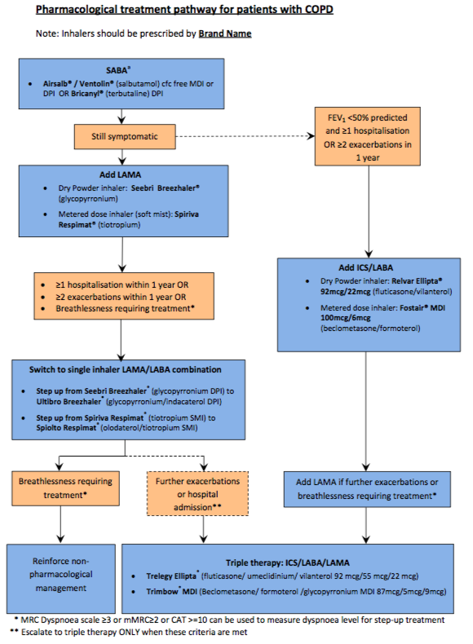
Notes:
Complete algorithm but impossible to read

Slide 7
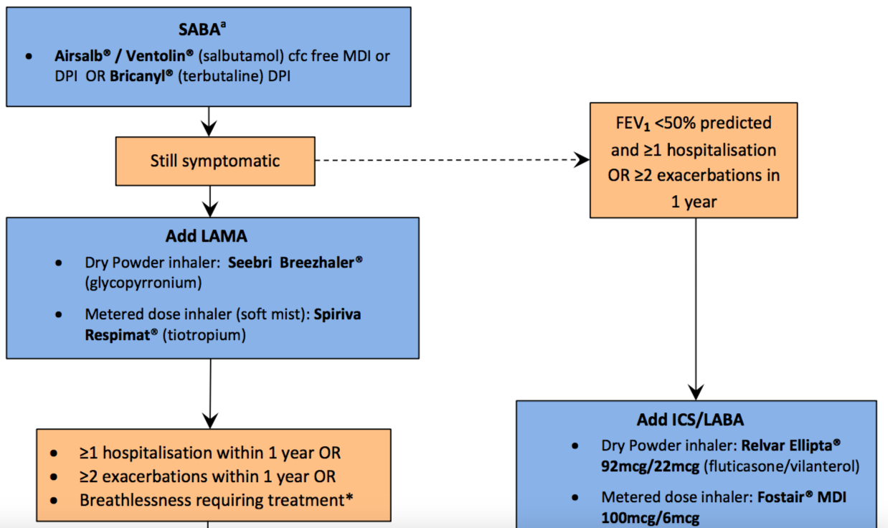
Notes:
Magnified

Slide 8
Make it easy to see
Who is playing this gig?

Slide 9
SABA
LAMA
ICS/LABA
LAMA/LABA
ICS/LAMA/LABA
My very simplified version!
Notes:
Simplified

Slide 10
SABA
Poor lung function AND frequent exacs
Sx
LAMA
ICS/LABA
Sx
LAMA/LABA
Sx
ICS/LAMA/LABA
My very simplified version!

Slide 12
Be careful with
your colours

Slide 13
Be prepared
PPPPPP
Fail to prepare, prepare to fail
Could be the difference between knowing your shit and knowing you’re shit
Rehearse obsessively vs “winging it”

Slide 14
Prepare
“If I am to speak ten minutes, I need a week for preparation; if fifteen minutes, three days; if half an hour, two days; if an hour, I am ready now.”
Woodrow Wilson

Slide 15
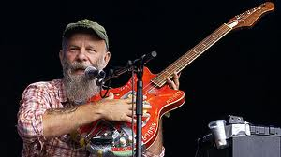
“I started out with nothing,
and I’ve still got most of it left”
Notes:
Make the best of what you’ve got

Slide 16
Be Yourself

Slide 17
Be Yourself
(unless you can be Batman, in which case be Batman!)

Slide 18
Your body language
Face the audience
Make eye contact
Decide what you’re doing with your hands & feet
Standing still or wandering?
Be a little bit Mediterranean (but not too much!)
Notes:
Expand on this

Slide 19
Discuss the following few slides …

Slide 20
Notes:
What creates purpose is positive psychology – happiness and joy!
I use lots of photos, message should be clear when you explain their purpose

Slide 21
Notes:
Lots of words but what’s the point made?

Slide 22
Asthma: The scale of the problem //
5.4 million
People living with asthma in the UK
Every 10 seconds someone is having a potentially life-threatening asthma attack in the UK
Every day, the lives of three families are devastated by the death of a loved one to an asthma attack…
…yet two-thirds of these deaths are preventable
Asthma UK. Asthma facts and statistics [online] 2016. Available from: https://www.asthma.org.uk/about/media/facts-and-statistics/ [Last accessed: December, 2016].
Notes:
Emphasises important points, good use of pictures

Slide 23
Breathe!
There was a young man from Japan
Whose limericks never would scan
When told this was so
He replied “Yes I know”
“But I always try to squeeze as many words into the last line
as ever I possibly can”

Slide 24
Know your enemy/audience

Slide 25
Simple powerpoint guidelines
No more than 7 words per line?
No more than 7 lines per slide?
Don’t overload them with data slides
Keep background and text contrasting & simple
Animations or building slides
Win hearts and minds early
Story-telling is key
Check your audience is following you
Notes:
Did you spot the 8 lines?
No hard and fast rules, many ways to swing a cat

Slide 26
“They’ve got a wall in China,
It’s a thousand miles long.
To keep out the foreigners
They made it strong.
And I’ve got a wall around me
That you can’t even see.
It takes a little time
To get next to me.”
Paul Simon – “Something so right”
Notes:
Another example/point

Slide 27
Look after yourself, so you can better look after others
Safety, dignity, resilience
Notes:
Just love this picture, as these are leaders a reminder to look after yourself!

